Slide 1


What is LSSSE?
Law School Survey of Student Engagement 2007 - NUSL
Measures the extent to which law students devote time and energy to educationally sound activities and the policies and practices that law schools use to induce students to take part in such activities.
Co-Sponsored by:
Notes:
Co-sponsored by the Association of American Law Schools (AALS) and The Carnegie Foundation for the Advancement of Teaching
“In part, student engagement represents activities that are traditionally associated with learning, such as reading and writing, preparing for class, and interacting with instructors about various matters. The engagement concept also encompasses some other key behaviors that more recently have come to the fore as being important, such as collaborating with peers on projects, problem solving tasks, and community service. These activities are valuable in and of themselves. They also are indicators of educational effectiveness. That is, educationally effective institutions intentionally use policies and practices that induce students to expend more effort on productive activities. For example, collaborative learning strategies promote peer interaction which, in turn, can stimulate individual and group learning as students work together to seek answers and solve problems. Students are often motivated to work harder and tend to learn more in the company of peers (p. 406).”
Patrick T. O’Day & George D. Kuh, Assessing What Matters in Law Schools: The Law School Survey of Student Engagement, 81 IND. L.J. 401, 406 (2007).

Slide 2


What is law student engagement:
Two components
Law students devote time and energy to educationally purposeful activities
Law schools use effective educational practices to encourage law students to succeed academically and professionally
Notes:
Looking behind student outcomes and student engagement:
What do we know about students who enter our law school?
How are various student experiences (e.g., course-taking patterns, leadership roles) related to outcomes?
What is the student’s contribution to learning?
What do law students learn over time in a program of study?
How do out-of-class experiences contribute to learning?
What are law students able to do with what they know?
What judgments can law students make about their learning?
(Adapted from Hutchings, 1989)

Slide 3
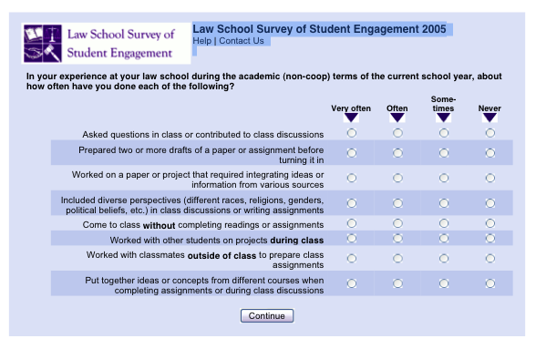
How Does LSSSE Work?
All JD students surveyed
Students fill out survey online
Multiple follow ups to increase response rates
Notes:
All JD students who have attended the law school for at least one semester/term are surveyed. Because the LSSSE survey is administered in the spring, students have at least one semester’s worth of experience upon which to reflect. This provides more reliable responses than if students were to be surveyed in the fall.
The customized e-mail invitations sent to students are electronically signed by the law school dean or another representative from your law school. This personalization reflects the law school’s interest in the results, and leads to higher response rates.

Slide 4

Why are Self-Reported
Answers Useful and Valid?
Requested information is known to respondents
Questions phrased clearly and unambiguously
Respondents take questions seriously and thoughtfully
Answering does not threaten, embarrass, violate privacy, or compel a socially desirable response
The LSSSE survey was designed to meet all of these conditions
Notes:
Does the instrument yield valid information?
Survey items are clearly worded, well-defined, and have high face and content validity. Logical relationships exist between the items in ways that are consistent with the results of objective measures and with other research.
Overall, the pattern of responses from 1L, 2L, 3L and 4L students suggest the items are measuring what they are supposed to measure.
Is the instrument stable?
Reliable measurement tools provide consistent readings from one administration to the next. In an effort to determine stability, we will examine whether students at the same law schools report their experiences in similar ways from one year to the next. Additional information will be posted on the LSSSE website in fall 2007.

Slide 5
Who participated in LSSSE?
Year | Law Schools | Respondents
2004 | 42 | 13,197
2007 | 53 | 21,653
2007 | 64 | 24,858
2007 | 79 | 25,770
56% response rate in 2007
128 different law schools in the US and Canada
Public and private law schools
Full-time and part-time law students
Notes:
The LSSSE conducted the third annual administration in spring 2007 with 79 participating law schools. All American law schools were invited to participate in the survey. A list of participating schools is included later in this presentation.
Institutional response rates ranged from 37% to 87%, with an average response rate of 56% per law school.
Since 2004 administration, 128 different law schools in the US and Canada have participated in LSSSE.

Slide 6

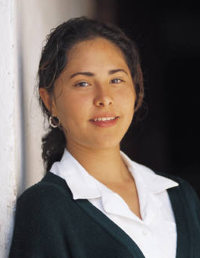
Law School Report 2007:
Comparison groups
Selected Peer Group (5 or more schools)
Size (less than 500, 500-900, more than 900 JD/LLB students)
Affiliation (public, private, religious)
All LSSSE 2007 schools
Notes:
Your law school data is compared to four normative groups:
self-selected peer group with at least five schools that participated in 2007 (or consortium if applicable)
schools with a similar number of JD/LLB students,
law schools with the same affiliation,
and all participating LSSSE 2007 law schools.
More information about interpreting these comparisons is available in the Interpreting the Means Comparison Report document included in the Law School Report 2007.

Slide 7
LSSSE 2007:
NUSL Selected Peer Group
American University, Washington College of Law Drexel University College of Law Emory University School of Law Seattle University School of Law Seton Hall University School of Law
Notes:
Those not participating in a consortium had the opportunity to select at least five schools that participated in 2007 as an additional comparison group. Write in the names of the law schools in your selected peer group or consortium. A list of your consortium or selected peer group schools can be found on page 3 of the Respondent Characteristics Table in your Law School Report 2007.

Slide 8
LSSSE 2007:
Less than 500 students
Akron
Campbell
Charlotte
CUNY Queens
Dalhousie
Drake
Drexel
Elon
Franklin Pierce
John Marshall
Northern Kentucky (Chase)
Ohio Northern
Phoenix
Quinnipiac
Samford – Cumberland
Southern Illinois
Southern University
University of Tulsa
Arkansas – Little Rock
Dayton
Idaho
Manitoba
Missouri – Kansas City
UNLV
New Brunswick
Ottawa – Civil Law
Saskatchewan
South Dakota
Utah
Victoria
Washburn
Notes:
Select the slide that represents your second comparison group based on the number of JD/LLB students surveyed.
See appendix in the Law School Report 2007 for all participating law schools, including formal names.

Slide 9
LSSSE 2007
500 – 900 students
British Columbia
Cleveland Marshall
Detroit Mercy
Emory
Georgia State
Gonzaga
Hamline
Indiana – Bloomington
Illinois
Lewis and Clark
Loyola – Chicago
Marquette
Maryland
Mississippi College
North Carolina Central
Northeastern University
Northern Kentucky
Osgoode Hall – York
Pace
Santa Clara
St. Thomas University
Syracuse
Texas Wesleyan
Ohio State
Ottawa – Common Law
Thomas Jefferson
Toronto
Touro College
South Carolina
Wayne State
Western New England
Western Ontario
Windsor
Notes:
Select the slide that represents your second comparison group based on the number of JD/LLB students surveyed.
See appendix in the Law School Report 2007 for all participating law schools, including formal names.

Slide 10
LSSSE 2007:
More than 900 students
American University
Concord Law School
Florida Coastal
Fordham
Hofstra
New York Law School
Seattle University
Seton Hall
Stetson University
Southwestern
Suffolk
Université de Montréal
University of Florida
University of Miami
University of the Pacific, McGeorge
Widener University
Notes:
Select the slide that represents your second comparison group based on the number of JD/LLB students surveyed.
See appendix in the Law School Report 2007 for all participating law schools, including formal names.

Slide 11
LSSSE 2007:
Private not religiously affiliated
American University | Hofstra | Southwestern
Charlotte | John Marshall | Suffolk
Concord | Lewis and Clark | Syracuse
Drake | New York Law | University of Tulsa
Drexel | Northeastern | Thomas Jefferson
Emory | Pace | University of Miami
Florida Coastal | Pacific, McGeroge | Western New England
Franklin Pierce | Phoenix | Widener University
Hamline | Quinnipiac
Notes:
Select the slide that represents your third comparison group based on the affiliation of your law school.
See appendix in the Law School Report 2007 for all participating law schools, including formal names.

Slide 12
Who Responded to LSSSE at Northeastern University School of Law?
54% response (339 students)
 | Respondents | Population | %
1L | 134 | 208 | 64%
2L | 102 | 214 | 48%
3L | 103 | 210 | 49%
 | Characteristics
Men | 125 | 339 | 37%
Women | 204 | 339 | 60%
I prefer not to respond | 10 | 339 | 3%
Notes:
The overall response rate for your law school is listed in your Respondent Characteristics Table in the Law School Report 2007.
Information about the number of respondents per class, by gender and enrollment status is available on your Law School Data File that is included electronically on your CD in SPSS (a statistical program).

Slide 13
Characteristics of Respondents
 | NUSL | Peer Group | All LSSSE 2007
American Indian/Native American | 0% | 0% | 0%
Asian/Asian American/Pacific Islander | 6% | 8% | 6%
Black/African American | 4% | 5% | 5%
White (not Hispanic) | 64% | 68% | 72%
Mexican/Mexican American | 1% | 2% | 1%
Puerto Rican | 0% | 1% | 1%
Other Hispanic/Latino | 3% | 4% | 2%
Multiracial | 4% | 3% | 2%
Bisexual | 3% | 1% | 1%
Gay or Lesbian | 9% | 3% | 2%
Heterosexual | 80% | 91% | 91%
Notes:
Information about the number of respondents by racial/ethnic identification is available on your Law School Data File that is included electronically on your CD in SPSS. This information also is included in your Respondent Characteristics Table and the Frequency Distribution in the Law School Report 2007.
Ethnicity codes according to US version of LSSSE 2007

Slide 14
Survey Results
The slides that follow give some examples of how NUSL students responded to the survey questions.
For questions where the NUSL student responses varied significantly from the others, we have also provided the responses from the comparison law school groups (by size, affiliation, or all survey participants). Where there is no comparative chart, you can assume that NUSL students were at or close to the norm for all students surveyed.

Slide 15
What percent of NUSL students asked questions in class or contributed to class discussions?
1L
99%
2L
98%
3L
96%
Notes:
This section utilizes data from your Law School Report 2007. Using this template, you can create additional slides that address areas of interest for your audience. Insert your law school name and data from your school’s Frequency Distribution Report .

Slide 16
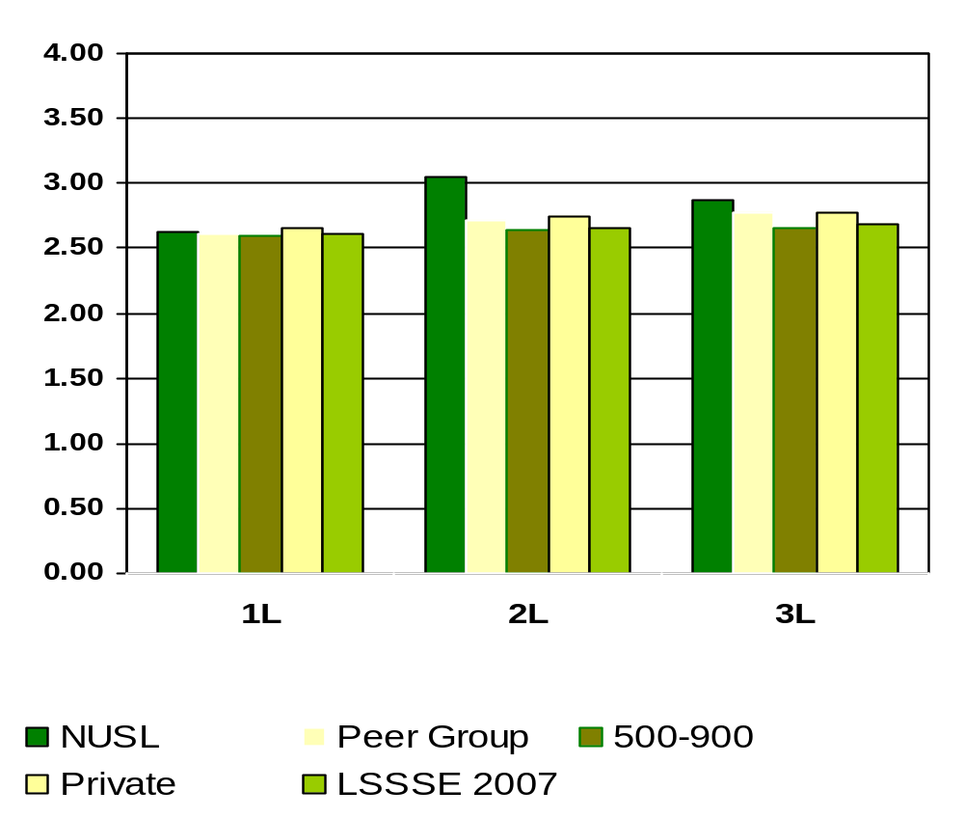
Asked Questions in Class or Contributed to a Class Discussion
Means of student responses on a scale of 1 to 4 where 1=Never and 4=Very Often
Notes:
Comparative data for these slides is available in the Means Comparisons section. Please enter for checked items only.
To modify this slide, double-click on the slide. Then, enter the appropriate data into the Excel table. Sample data is included in the chart above.

Slide 17
What percent of NUSL students prepared two or more drafts of a paper before turning it in?
1L
97%
2L
90%
3L
90%
Notes:
This section utilizes data from your Law School Report 2007. Using this template, you can create additional slides that address areas of interest for your audience. Insert your law school name and data from your school’s Frequency Distribution Report .

Slide 18
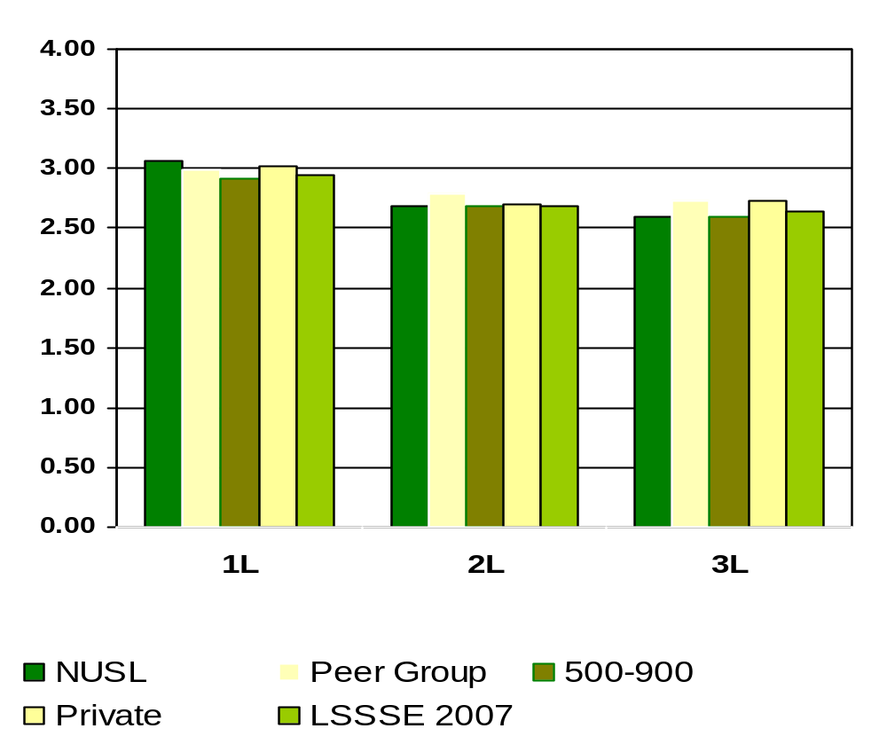
Prepared Two or More Drafts of a Paper or Assignment before turning it in
Means of student responses on a scale of 1 to 4 where 1=Never and 4=Very Often
Notes:
Comparative data for these slides is available in the Means Comparisons section. Please enter for checked items only.
To modify this slide, double-click on the slide. Then, enter the appropriate data into the Excel table. Sample data is included in the chart above.

Slide 19
What percent of NUSL students worked on a paper or project that required integrating ideas or information from various sources ?
1L
100%
2L
99%
3L
98%
Notes:
This section utilizes data from your Law School Report 2007. Using this template, you can create additional slides that address areas of interest for your audience. Insert your law school name and data from your school’s Frequency Distribution Report .

Slide 20
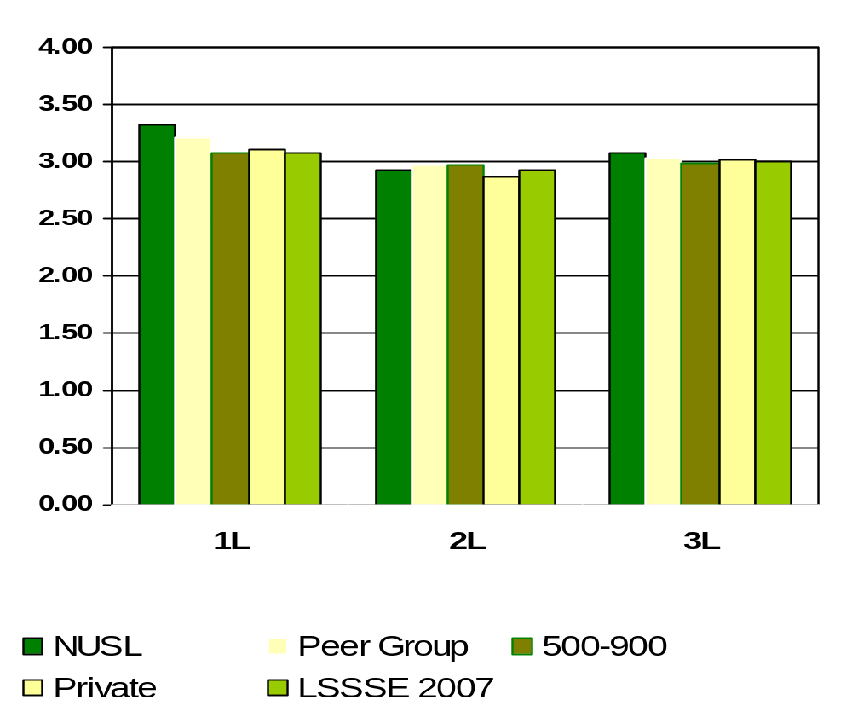
Worked on a paper or project that required integrating ideas or information from various sources.
Means of student responses on a scale of 1 to 4 where 1=Never and 4=Very Often
Notes:
Comparative data for these slides is available in the Means Comparisons section. Please enter for checked items only.
To modify this slide, double-click on the slide. Then, enter the appropriate data into the Excel table. Sample data is included in the chart above.

Slide 21
What percent of NUSL students included diverse perspectives (different races, religions, genders, political beliefs, etc.) in class discussions or writing assignments ?
1L
97%
2L
96%
3L
96%
Notes:
This section utilizes data from your Law School Report 2007. Using this template, you can create additional slides that address areas of interest for your audience. Insert your law school name and data from your school’s Frequency Distribution Report .

Slide 22
What percent of NUSL students worked with other students on projects DURING CLASS?
1L
83%
2L
81%
3L
87%
Notes:
This section utilizes data from your Law School Report 2007. Using this template, you can create additional slides that address areas of interest for your audience. Insert your law school name and data from your school’s Frequency Distribution Report .

Slide 23
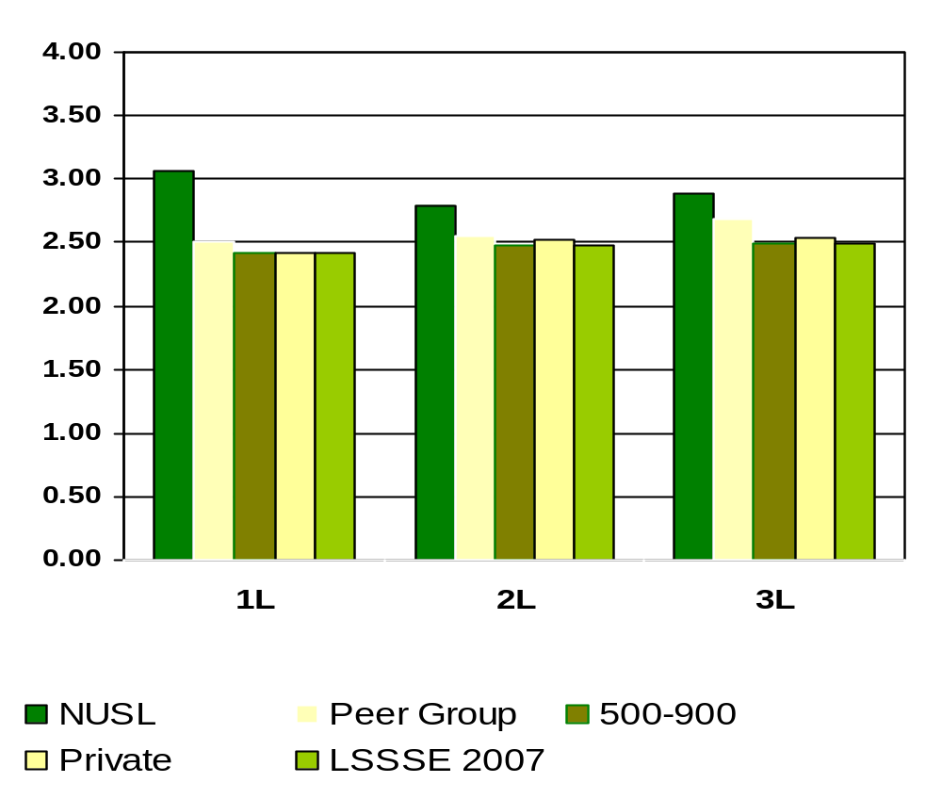
Included Diverse Perspective (different races, religions, genders, political beliefs, etc). In Class Discussions or Writing Assignments
Means of student responses on a scale of 1 to 4 where 1=Never and 4=Very Often
Notes:
Comparative data for these slides is available in the Means Comparisons section. Please enter for checked items only.
To modify this slide, double-click on the slide. Then, enter the appropriate data into the Excel table. Sample data is included in the chart above.

Slide 24
What percent of NUSL students worked with classmates OUTSIDE OF CLASS to prepare class assignments?
1L
98%
2L
96%
3L
93%
Notes:
This section utilizes data from your Law School Report 2007. Using this template, you can create additional slides that address areas of interest for your audience. Insert your law school name and data from your school’s Frequency Distribution Report .

Slide 25
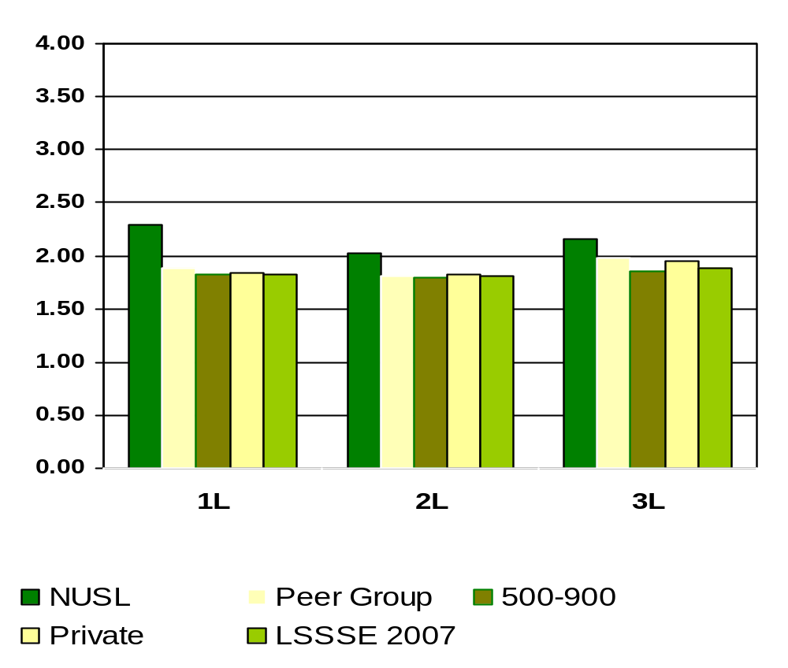
Worked with Other Students on Project During Class
Means of student responses on a scale of 1 to 4 where 1=Never and 4=Very Often
Notes:
Comparative data for these slides is available in the Means Comparisons section. Please enter for checked items only.
To modify this slide, double-click on the slide. Then, enter the appropriate data into the Excel table. Sample data is included in the chart above.

Slide 26
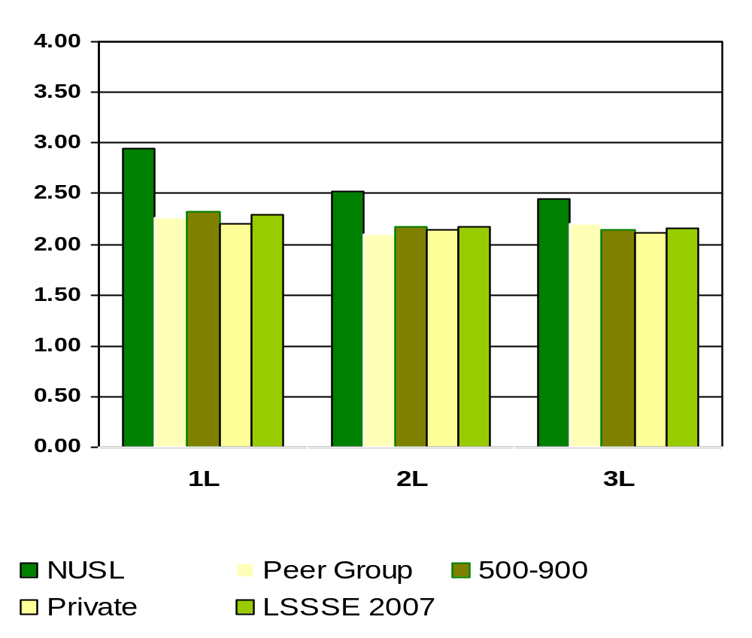
Worked with Classmates Outside of Class to Prepare Class Assignments
Means of student responses on a scale of 1 to 4 where 1=Never and 4=Very Often
Notes:
Comparative data for these slides is available in the Means Comparisons section. Please enter for checked items only.
To modify this slide, double-click on the slide. Then, enter the appropriate data into the Excel table. Sample data is included in the chart above.

Slide 27
What percent of NUSL students put together ideas or concepts from different courses when completing assignments or during class discussions ?
1L
98%
2L
96%
3L
96%
Notes:
This section utilizes data from your Law School Report 2007. Using this template, you can create additional slides that address areas of interest for your audience. Insert your law school name and data from your school’s Frequency Distribution Report .

Slide 28
What percent of NUSL students participated in a clinical or pro bono project as part of a course or for academic credit?
1L
55%
2L
49%
3L
72%
Notes:
This section utilizes data from your Law School Report 2007. Using this template, you can create additional slides that address areas of interest for your audience. Insert your law school name and data from your school’s Frequency Distribution Report .

Slide 29
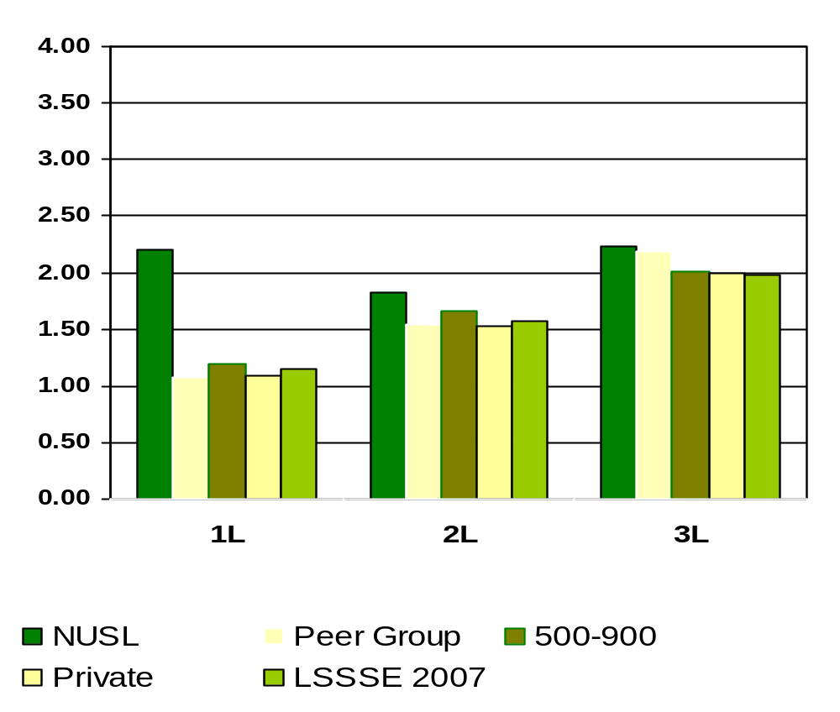
Participated in a Clinical or Pro Bono Project as Part of a Course or for Academic Credit
Means of student responses on a scale of 1 to 4 where 1=Never and 4=Very Often
Notes:
Comparative data for these slides is available in the Means Comparisons section. Please enter for checked items only.
To modify this slide, double-click on the slide. Then, enter the appropriate data into the Excel table. Sample data is included in the chart above.

Slide 30
What percent of NUSL students used an electronic medium (listserv, chat group, Internet, instant messaging, etc.) to discuss or complete an assignment?
1L
88%
2L
93%
3L
87%
Notes:
This section utilizes data from your Law School Report 2007. Using this template, you can create additional slides that address areas of interest for your audience. Insert your law school name and data from your school’s Frequency Distribution Report .

Slide 31
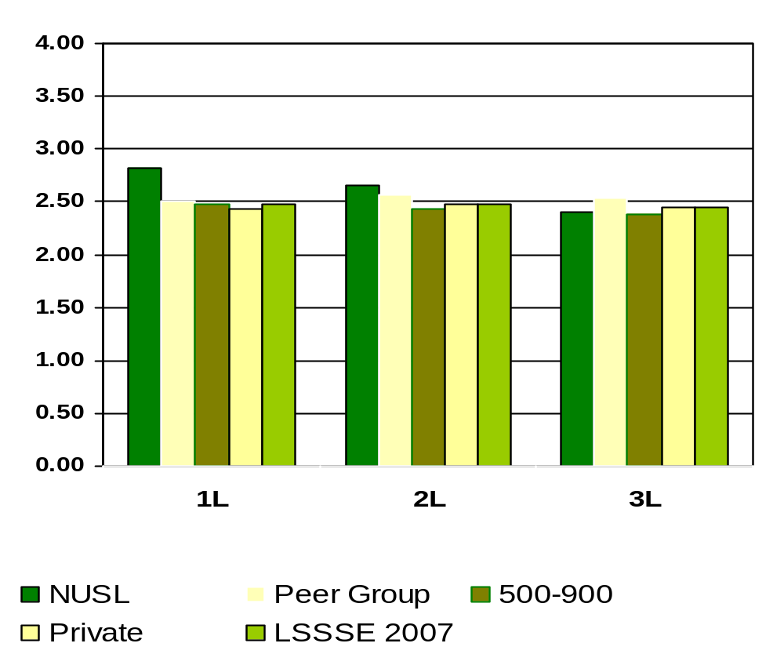
Used an Electronic Medium (listserv, chat group, Internet, instant messaging, etc.) to Discuss or Complete an Assignment
Means of student responses on a scale of 1 to 4 where 1=Never and 4=Very Often
Notes:
Comparative data for these slides is available in the Means Comparisons section. Please enter for checked items only.
To modify this slide, double-click on the slide. Then, enter the appropriate data into the Excel table. Sample data is included in the chart above.

Slide 32
What percent of NUSL students had serious conversations with students of a different race or ethnicity than their own?
1L
98%
2L
97%
3L
98%
Notes:
This section utilizes data from your Law School Report 2007. Using this template, you can create additional slides that address areas of interest for your audience. Insert your law school name and data from your school’s Frequency Distribution Report .

Slide 33
What percent of NUSL students felt the law school environment encourages contact among students from different economic, social, and racial or ethnic backgrounds?
1L
88%
2L
96%
3L
96%
Percentages measure students who believe “Some”, “Quite a bit” or “Very much” versus “Very Little”
Notes:
This section utilizes data from your Law School Report 2007. Using this template, you can create additional slides that address areas of interest for your audience. Insert your law school name and data from your school’s Frequency Distribution Report .

Slide 34
What percentage of NUSL students believe the law school contributed to understanding people of other racial and ethnic backgrounds?
1L
84%
2L
85%
3L
87%
Percentages measure students who believe “Some”, “Quite a bit” or “Very much” versus “Very Little”
Notes:
This section utilizes data from your Law School Report 2007. Using this template, you can create additional slides that address areas of interest for your audience. Insert your law school name and data from your school’s Frequency Distribution Report .

Slide 35
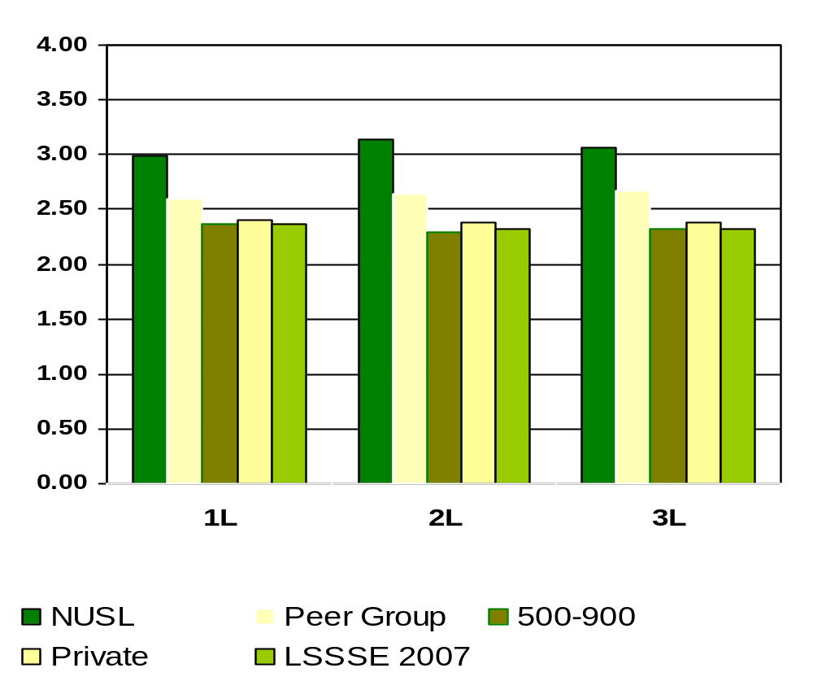
How Much Does Law School Emphasize Encouraging Contact Among Students from Different Economical, Social and Racial or Ethnic Backgrounds
Means of student responses on a scale of 1 to 4 where 1=Very Little and 4=Very Much
Notes:
Comparative data for these slides is available in the Means Comparisons section. Please enter for checked items only.
To modify this slide, double-click on the slide. Then, enter the appropriate data into the Excel table. Sample data is included in the chart above.

Slide 36
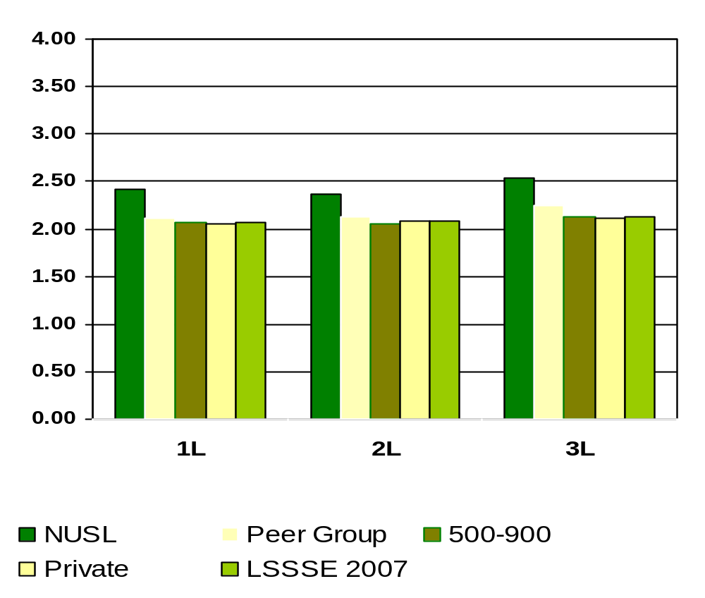
How Much Law School Experience Contributed to Understanding People of Other Racial and Ethnic Backgrounds
Means of student responses on a scale of 1 to 4 where 1=Very Little and 4=Very Much
Notes:
Comparative data for these slides is available in the Means Comparisons section. Please enter for checked items only.
To modify this slide, double-click on the slide. Then, enter the appropriate data into the Excel table. Sample data is included in the chart above.

Slide 37
What percent of NUSL students felt coursework emphasized memorizing facts, ideas or methods quite a bit or very much of the time
1L
43%
2L
43%
3L
29%
Notes:
This section utilizes data from your Law School Report 2007. Using this template, you can create additional slides that address areas of interest for your audience. Insert your law school name and data from your school’s Frequency Distribution Report .

Slide 38
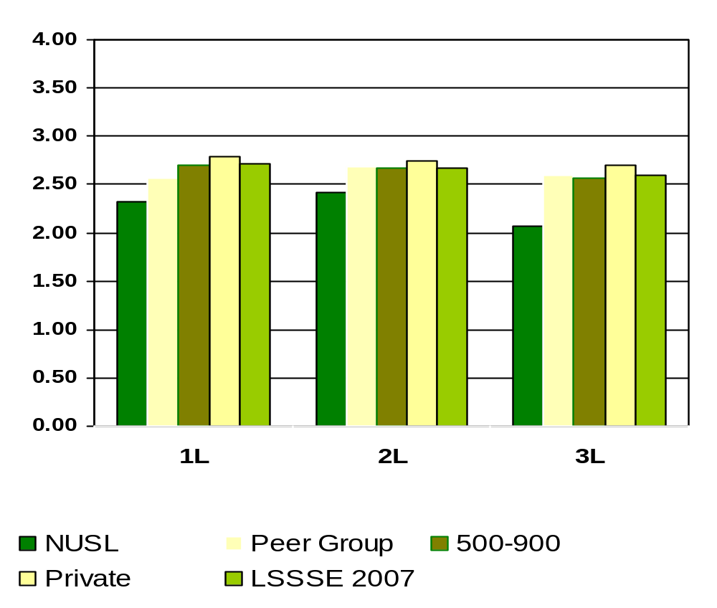
Memorizing Facts, Ideas, or Methods from Your Courses and Readings so You Can Repeat Them Pretty Much in the Same Form
Means of student responses on a scale of 1 to 4 where 1=Very Little and 4=Very Much
Notes:
Comparative data for these slides is available in the Means Comparisons section. Please enter for checked items only.
To modify this slide, double-click on the slide. Then, enter the appropriate data into the Excel table. Sample data is included in the chart above.

Slide 39
During the current school year, what percent of NUSL students had written at least one paper of FEWER THAN 5 PAGES?
1L
82%
2L
97%
3L
93%
Notes:
This section utilizes data from your Law School Report 2007. Using this template, you can create additional slides that address areas of interest for your audience. Insert your law school name and data from your school’s Frequency Distribution Report .

Slide 40
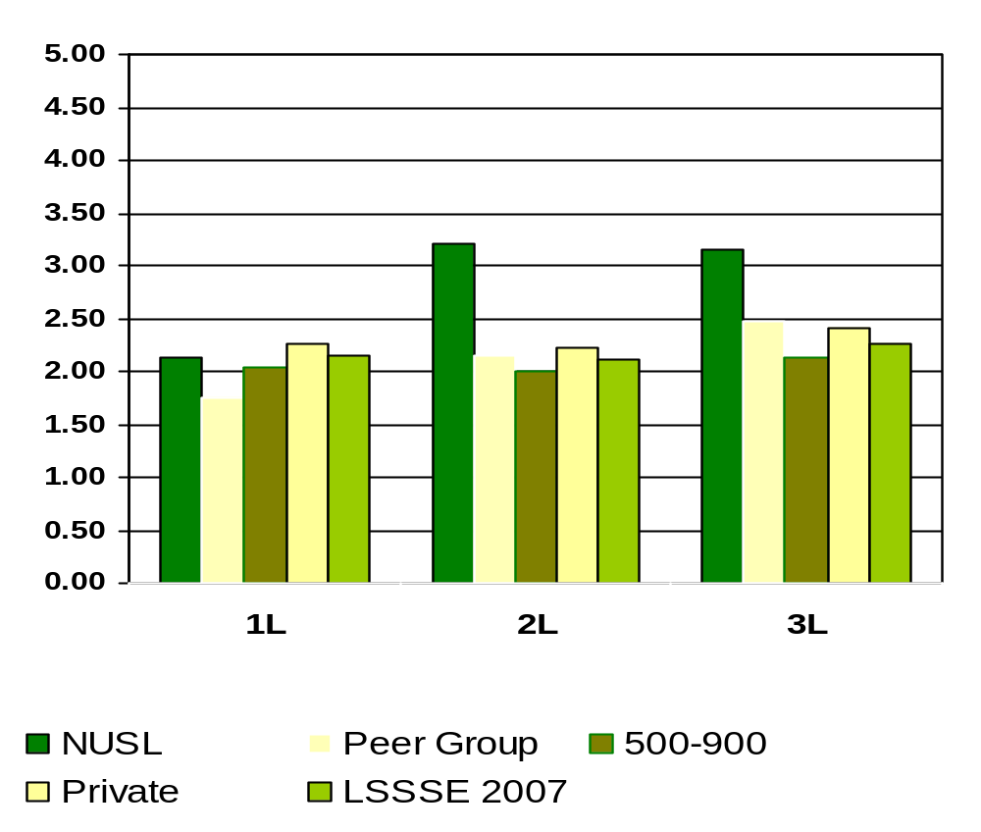
Number of Written Pages of Fewer than 5 pages
Means of student responses on a scale of 1 to 5 where 1=0 papers, 2=1-3 papers, 3=4-6 papers, 4=7-9 papers, 5=10 or more papers.
Notes:
Comparative data for these slides is available in the Means Comparisons section. Please enter for checked items only.
To modify this slide, double-click on the slide. Then, enter the appropriate data into the Excel table. Sample data is included in the chart above.

Slide 41
During the current school year, what percent of NUSL students had written at least one paper of BETWEEN 5 AND 19 PAGES?
1L
98%
2L
92%
3L
92%
Notes:
This section utilizes data from your Law School Report 2007. Using this template, you can create additional slides that address areas of interest for your audience. Insert your law school name and data from your school’s Frequency Distribution Report .

Slide 42
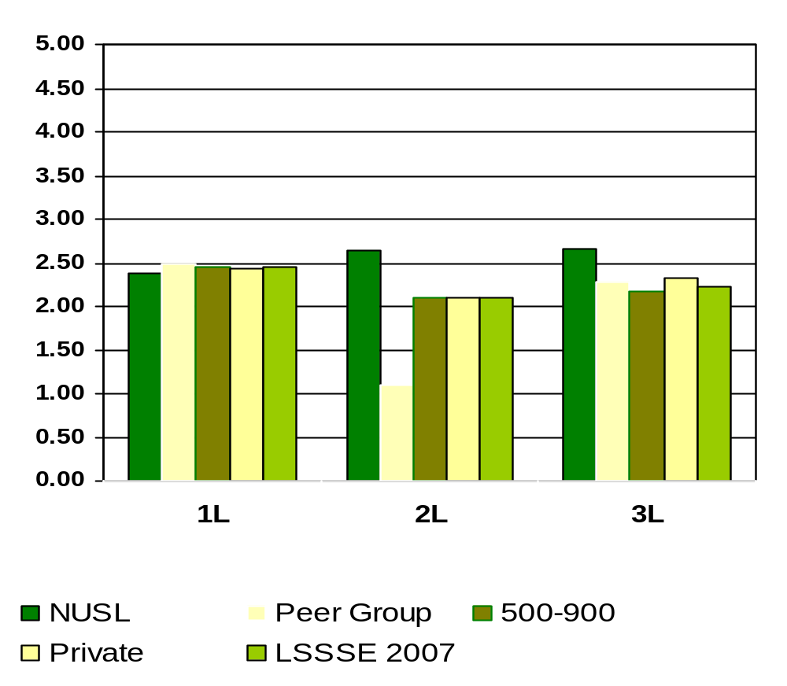
Number of Written Papers between 5 and 19 Pages
Means of student responses on a scale of 1 to 5 where 1=0 papers, 2=1-3 papers, 3=4-6 papers, 4=7-9 papers, 5=10 or more papers.
Notes:
Comparative data for these slides is available in the Means Comparisons section. Please enter for checked items only.
To modify this slide, double-click on the slide. Then, enter the appropriate data into the Excel table. Sample data is included in the chart above.

Slide 43
During the current school year, what percent of NUSL students had written at least one paper of 20 PAGES OR MORE?
1L
64%
2L
65%
3L
80%
Notes:
This section utilizes data from your Law School Report 2007. Using this template, you can create additional slides that address areas of interest for your audience. Insert your law school name and data from your school’s Frequency Distribution Report .

Slide 44
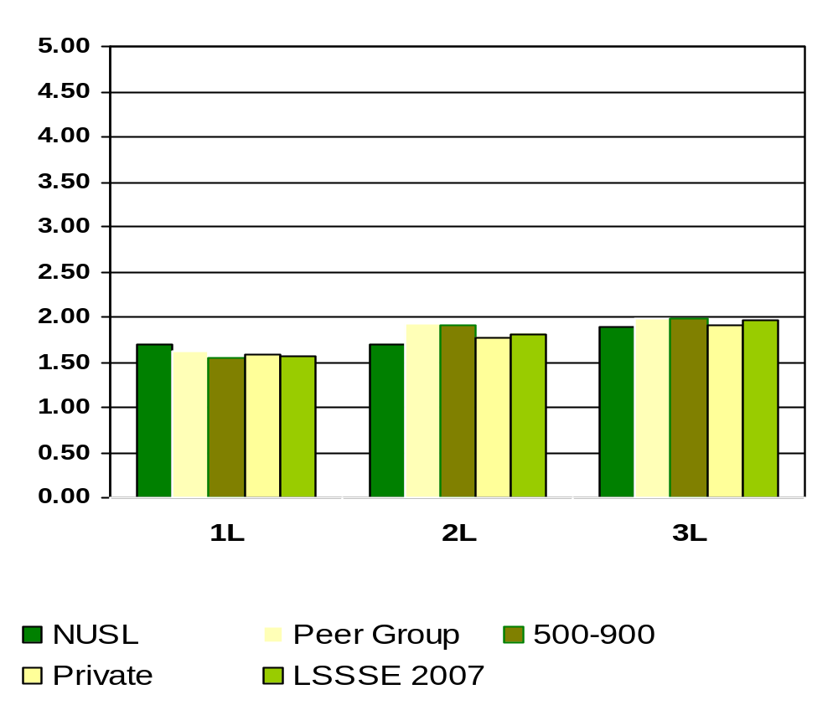
Number of Written Papers of 20 Pages or More
Means of student responses on a scale of 1 to 5 where 1=0 papers, 2=1-3 papers, 3=4-6 papers, 4=7-9 papers, 5=10 or more papers.
Notes:
Comparative data for these slides is available in the Means Comparisons section. Please enter for checked items only.
To modify this slide, double-click on the slide. Then, enter the appropriate data into the Excel table. Sample data is included in the chart above.

Slide 45
Hours per Week Spent
Reading Assigned Class Materials
What percentage of NUSL students spent more than 20 hours per week reading assigned textbooks, online class reading, and other course materials?
1L
60%
2L
33%
3L
23%
Notes:
This section utilizes data from your Law School Report 2007. Using this template, you can create additional slides that address areas of interest for your audience. Insert your law school name and data from your school’s Frequency Distribution Report.

Slide 46
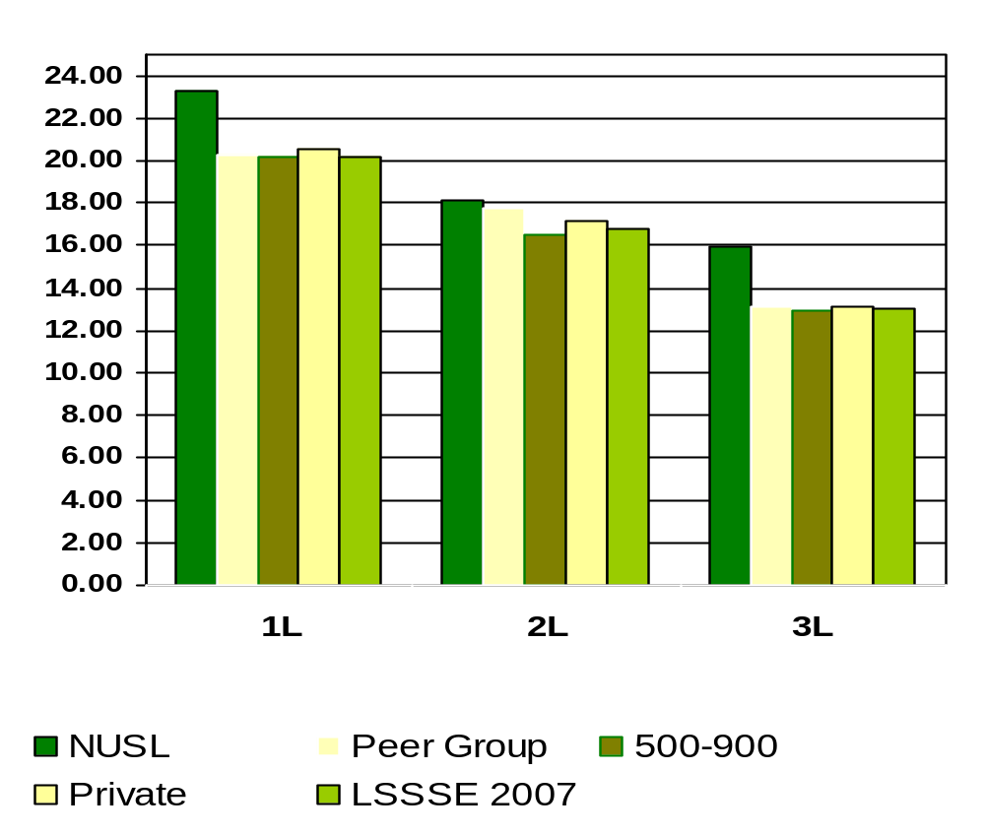
Reading Assigned Textbooks, Online Class Reading, and Other Course Materials
Means of student responses on a scale of hours per week reading
Notes:
Comparative data for these slides is available in the Means Comparisons section. Please enter for checked items only.
To modify this slide, double-click on the slide. Then, enter the appropriate data into the Excel table. Sample data is included in the chart above.

Slide 47
Hours per Week Spent
Preparing for Class and Clinical Courses OTHER THAN READING?
What percentage of NUSL students spent more than 10 hours per week preparing for class and clinical courses OTHER THAN READING?
1L
32%
2L
27%
3L
18%
Notes:
This section utilizes data from your Law School Report 2007. Using this template, you can create additional slides that address areas of interest for your audience. Insert your law school name and data from your school’s Frequency Distribution Report.

Slide 48
Worked for Pay in
Law-Related or Nonlegal Job
What percentage of NUSL students worked for pay in either law-related or nonlegal jobs?
1L
27%
2L
53%
3L
63%
Notes:
This section utilizes data from your Law School Report 2007. Using this template, you can create additional slides that address areas of interest for your audience. Insert your law school name and data from your school’s Frequency Distribution Report.

Slide 49
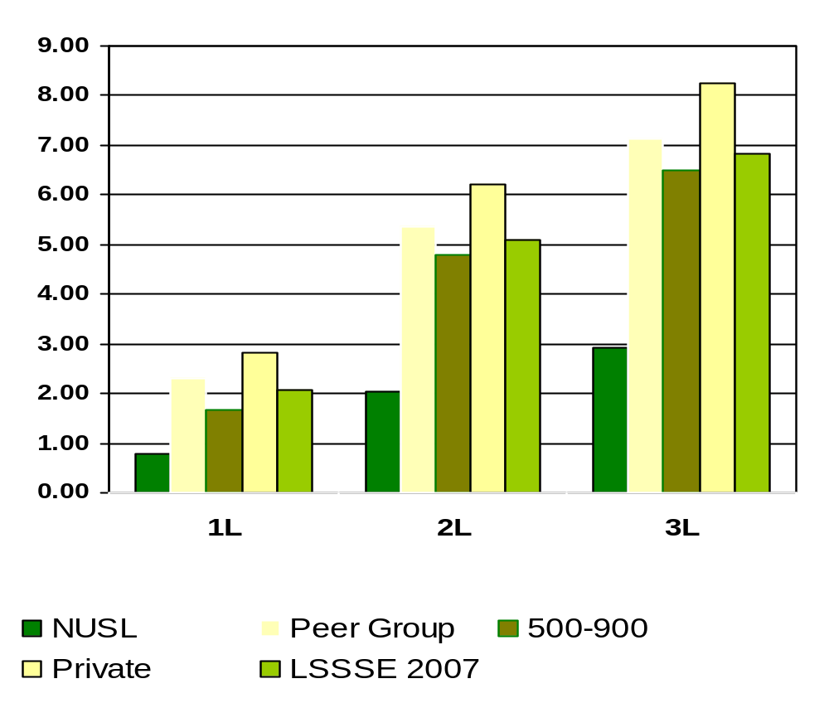
Working for Pay in Law-Related Job
Means of student responses based on numbers of hours worked.
Notes:
Comparative data for these slides is available in the Means Comparisons section. Please enter for checked items only.
To modify this slide, double-click on the slide. Then, enter the appropriate data into the Excel table. Sample data is included in the chart above.

Slide 50
What percent of NUSL students come to class often or very often WITHOUT completing readings or assignments ?
1L
6%
2L
14%
3L
16%
Notes:
This section utilizes data from your Law School Report 2007. Using this template, you can create additional slides that address areas of interest for your audience. Insert your law school name and data from your school’s Frequency Distribution Report .

Slide 51
What percent of NUSL students had discussed assignments with a faculty member?
1L
87%
2L
92%
3L
94%
Notes:
This section utilizes data from your Law School Report 2007. Using this template, you can create additional slides that address areas of interest for your audience. Insert your law school name and data from your school’s Frequency Distribution Report .

Slide 52
What percent of NUSL students discussed ideas from readings or classes with faculty members outside of class?
1L
75%
2L
81%
3L
70%
Notes:
This section utilizes data from your Law School Report 2007. Using this template, you can create additional slides that address areas of interest for your audience. Insert your law school name and data from your school’s Frequency Distribution Report .

Slide 53
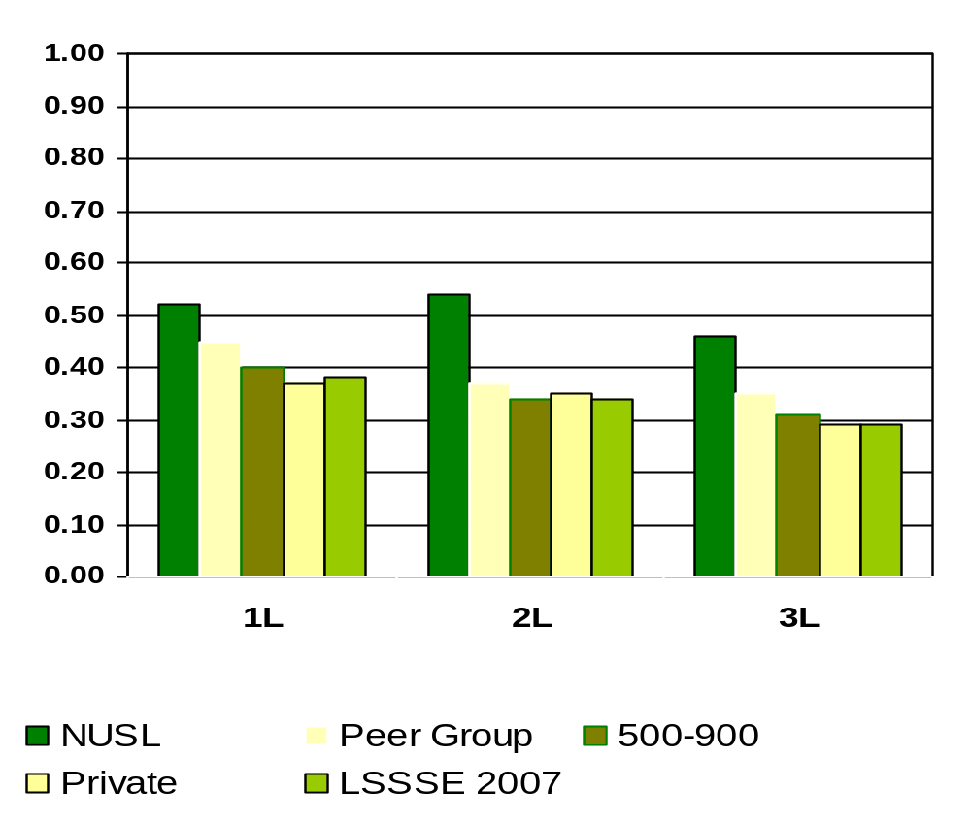
Worked on a Legal Research Project with a Faculty Member Outside of Course or Program Requirements
Means of student responses on a scale of 0 to 1 where 0=Undecided or do not plan to do and 1=Done or plan to do
Notes:
Comparative data for these slides is available in the Means Comparisons section. Please enter for checked items only.
To modify this slide, double-click on the slide. Then, enter the appropriate data into the Excel table. Sample data is included in the chart above.

Slide 54
What percent of NUSL students analyzed the basic elements of an idea, experience, or theory, such as examining a particular case or situation in depth?
1L
94%
2L
89%
3L
88%
Percentages measure students who complete above tasks either “Quite a bit” or “Very much” versus “Very Little” or “Some”
Notes:
This section utilizes data from your Law School Report 2007. Using this template, you can create additional slides that address areas of interest for your audience. Insert your law school name and data from your school’s Frequency Distribution Report .

Slide 55
What percent of NUSL students synthesized and organized ideas, information, or experiences into new, more complex interpretations and relationships?
1L
87%
2L
84%
3L
86%
Percentages measure students who complete above tasks either “Quite a bit” or “Very much” versus “Very Little” or “Some”
Notes:
This section utilizes data from your Law School Report 2007. Using this template, you can create additional slides that address areas of interest for your audience. Insert your law school name and data from your school’s Frequency Distribution Report .

Slide 56
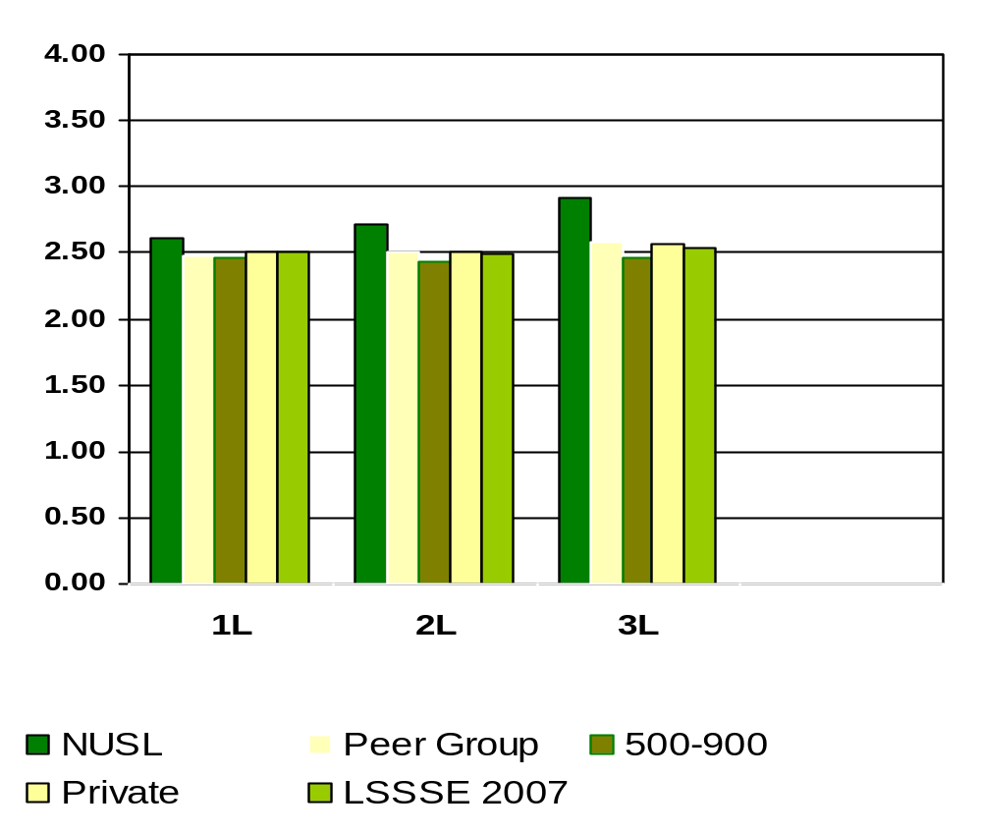
How Much Law School Experience Contributed to Solving Complex and Real-World Problems
Means of student responses on a scale of 1 to 4 where 1=Very Little and 4=Very Much
Notes:
Comparative data for these slides is available in the Means Comparisons section. Please enter for checked items only.
To modify this slide, double-click on the slide. Then, enter the appropriate data into the Excel table. Sample data is included in the chart above.

Slide 57
What percent of NUSL students made judgments about the value of information, arguments, or methods, such as examining how others gathered and interpreted data and assessing the soundness of their conclusions?
1L
87%
2L
71%
3L
75%
Percentages measure students who complete above tasks either “Quite a bit” or “Very much” versus “Very Little” or “Some”
Notes:
This section utilizes data from your Law School Report 2007. Using this template, you can create additional slides that address areas of interest for your audience. Insert your law school name and data from your school’s Frequency Distribution Report .

Slide 58
What percent of NUSL students applied theories or concepts to practical problems or in new situations?
1L
84%
2L
82%
3L
90%
Percentages measure students who complete above tasks either “Quite a bit” or “Very much” versus “Very Little” or “Some”
Notes:
This section utilizes data from your Law School Report 2007. Using this template, you can create additional slides that address areas of interest for your audience. Insert your law school name and data from your school’s Frequency Distribution Report .

Slide 59
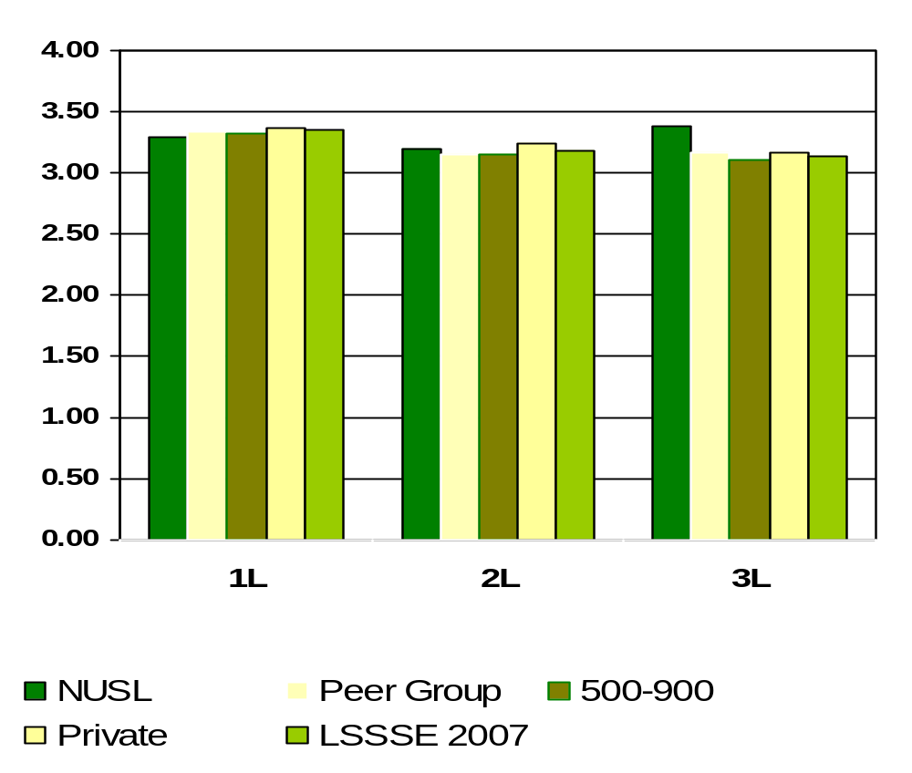
Applying theories or concepts to practical problems or in new situations
Means of student responses on a scale of 1 to 4 where 1=Very Little and 4=Very Much
Notes:
Comparative data for these slides is available in the Means Comparisons section. Please enter for checked items only.
To modify this slide, double-click on the slide. Then, enter the appropriate data into the Excel table. Sample data is included in the chart above.

Slide 60
What percent of NUSL students felt satisfaction with academic advising and planning?
1L
60%
2L
53%
3L
52%
Percentages measure students who are either “Satisfied” or “Very satisfied” versus “Not Used”, “Very unsatisfied” or “Unsatisfied”
Notes:
This section utilizes data from your Law School Report 2007. Using this template, you can create additional slides that address areas of interest for your audience. Insert your law school name and data from your school’s Frequency Distribution Report .

Slide 61
What percent of NUSL students felt satisfaction with career counseling?
1L
54%
2L
50%
3L
61%
Percentages measure students who are either “Satisfied” or “Very satisfied” versus “Not Used”, “Very unsatisfied” or “Unsatisfied”
Notes:
This section utilizes data from your Law School Report 2007. Using this template, you can create additional slides that address areas of interest for your audience. Insert your law school name and data from your school’s Frequency Distribution Report .

Slide 62
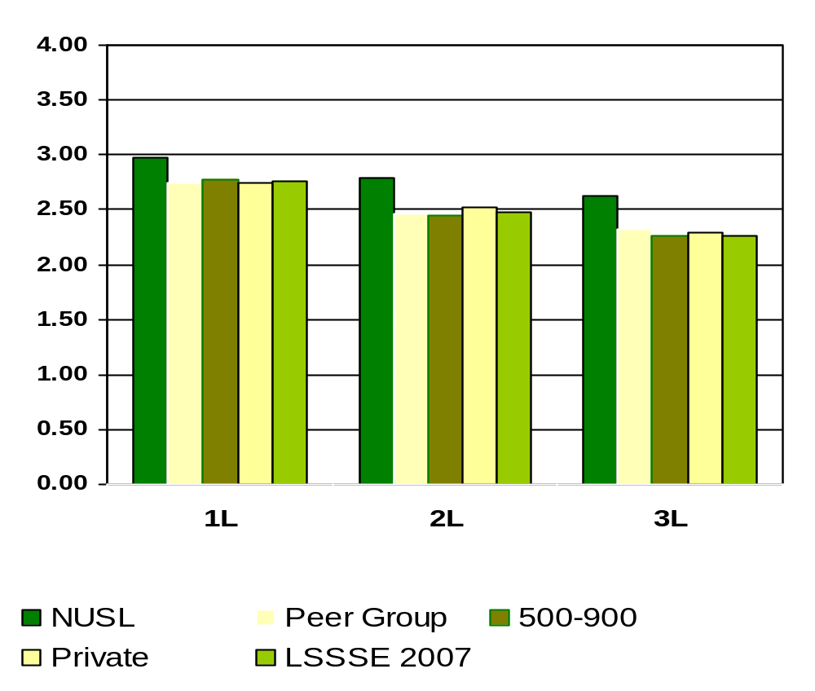
Satisfaction with Career Counseling
Means of student responses on a scale of 1 to 4 where 1=Very Unsatisfied and 4=Very Satisfied
Notes:
Comparative data for these slides is available in the Means Comparisons section. Please enter for checked items only.
To modify this slide, double-click on the slide. Then, enter the appropriate data into the Excel table. Sample data is included in the chart above.

Slide 63
What percent of NUSL students talked about career plans or job search activities with a faculty member or advisor?
1L
73%
2L
78%
3L
87%
Notes:
This section utilizes data from your Law School Report 2007. Using this template, you can create additional slides that address areas of interest for your audience. Insert your law school name and data from your school’s Frequency Distribution Report .

Slide 64
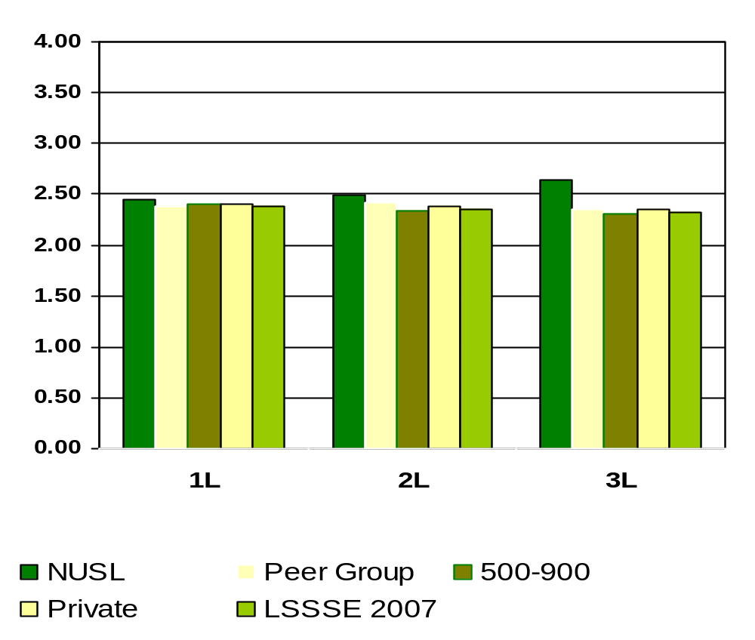
How Much Law School Experience Contributed to Developing Clearer Career Goals
Means of student responses on a scale of 1 to 4 where 1=Very Little and 4=Very Much
Notes:
Comparative data for these slides is available in the Means Comparisons section. Please enter for checked items only.
To modify this slide, double-click on the slide. Then, enter the appropriate data into the Excel table. Sample data is included in the chart above.

Slide 65
What percent of NUSL students felt satisfaction with job search help?
1L
50%
2L
47%
3L
55%
Percentages measure students who are either “Satisfied” or “Very satisfied” versus “Not Used”, “Very unsatisfied” or “Unsatisfied”
Notes:
This section utilizes data from your Law School Report 2007. Using this template, you can create additional slides that address areas of interest for your audience. Insert your law school name and data from your school’s Frequency Distribution Report .

Slide 66
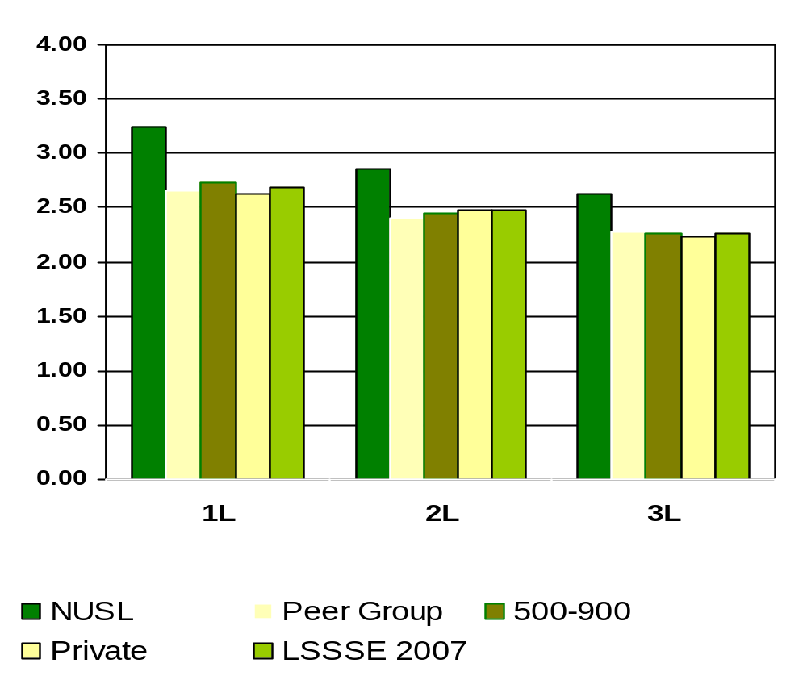
Satisfaction with Job Search Help
Means of student responses on a scale of 1 to 4 where 1=Very Unsatisfied and 4=Very Satisfied
Notes:
Comparative data for these slides is available in the Means Comparisons section. Please enter for checked items only.
To modify this slide, double-click on the slide. Then, enter the appropriate data into the Excel table. Sample data is included in the chart above.

Slide 67
What percent of NUSL students felt satisfaction with personal counseling?
1L
32%
2L
21%
3L
54%
Percentages measure students who are either “Satisfied” or “Very satisfied” versus “Not Used”, “Very unsatisfied” or “Unsatisfied”
Notes:
This section utilizes data from your Law School Report 2007. Using this template, you can create additional slides that address areas of interest for your audience. Insert your law school name and data from your school’s Frequency Distribution Report .

Slide 68
What percent of NUSL students felt satisfaction with financial aid advising?
1L
54%
2L
65%
3L
65%
Percentages measure students who are either “Satisfied” or “Very satisfied” versus “Not Used”, “Very unsatisfied” or “Unsatisfied”
Notes:
This section utilizes data from your Law School Report 2007. Using this template, you can create additional slides that address areas of interest for your audience. Insert your law school name and data from your school’s Frequency Distribution Report .

Slide 69
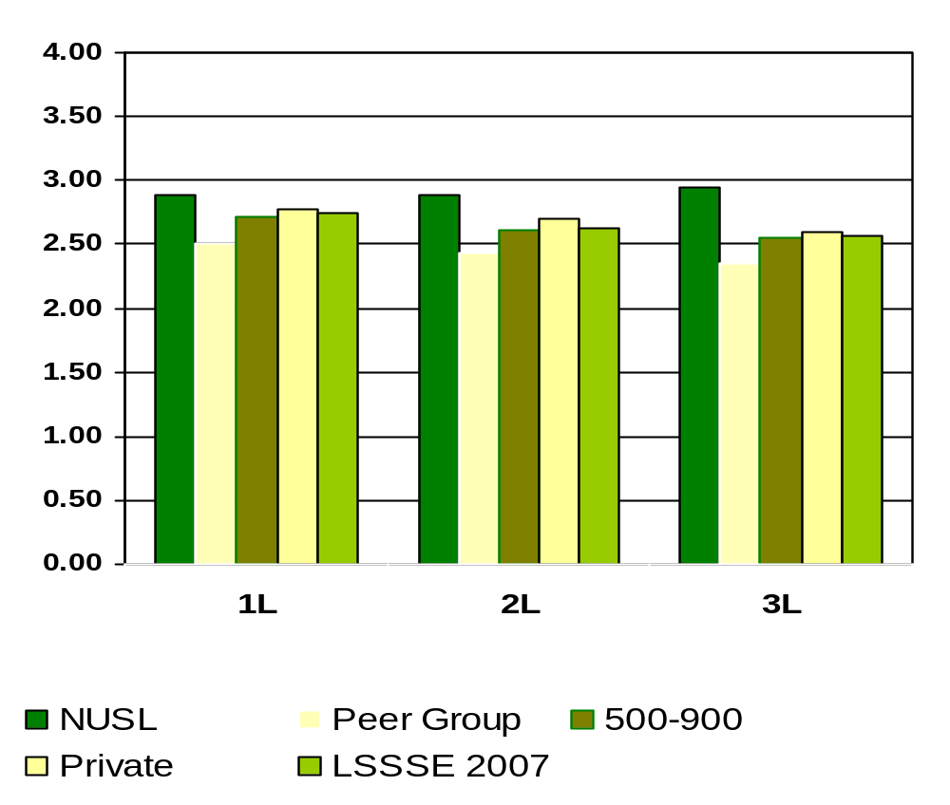
Satisfaction with Financial Aid Advising
Means of student responses on a scale of 1 to 4 where 1=Very Unsatisfied and 4=Very Satisfied
Notes:
Comparative data for these slides is available in the Means Comparisons section. Please enter for checked items only.
To modify this slide, double-click on the slide. Then, enter the appropriate data into the Excel table. Sample data is included in the chart above.

Slide 70
What percent of NUSL students felt satisfaction with library assistance?
1L
79%
2L
90%
3L
89%
Percentages measure students who are either “Satisfied” or “Very satisfied” versus “Not Used”, “Very unsatisfied” or “Unsatisfied”
Notes:
This section utilizes data from your Law School Report 2007. Using this template, you can create additional slides that address areas of interest for your audience. Insert your law school name and data from your school’s Frequency Distribution Report .

Slide 71
What percentage of NUSL students believe the law school contributed to developing their use of computing and information technology?
1L
44%
2L
32%
3L
36%
Percentages measure students who believe “Quite a bit” or “Very much” versus “Some” or “Very Little”
Notes:
This section utilizes data from your Law School Report 2007. Using this template, you can create additional slides that address areas of interest for your audience. Insert your law school name and data from your school’s Frequency Distribution Report .

Slide 72
What percent of NUSL students felt satisfaction with computing technology?
1L
64%
2L
60%
3L
65%
Percentages measure students who are either “Satisfied” or “Very satisfied” versus “Not Used”, “Very unsatisfied” or “Unsatisfied”
Notes:
This section utilizes data from your Law School Report 2007. Using this template, you can create additional slides that address areas of interest for your audience. Insert your law school name and data from your school’s Frequency Distribution Report .

Slide 73
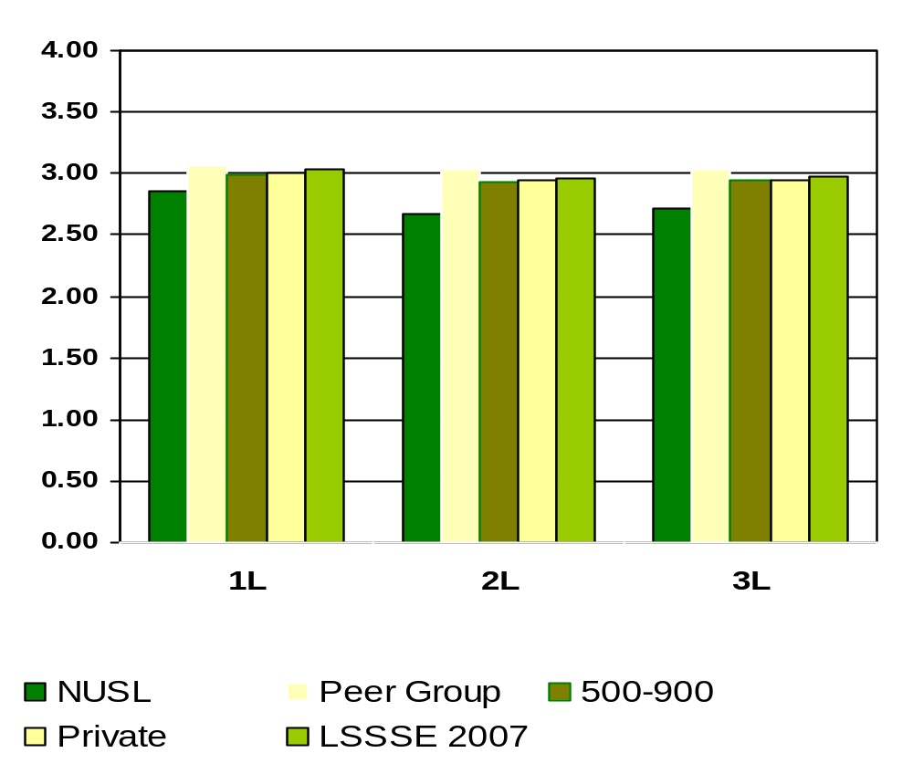
Satisfaction with Computing Technology
Means of student responses on a scale of 1 to 4 where 1=Very Unsatisfied and 4=Very Satisfied
Notes:
Comparative data for these slides is available in the Means Comparisons section. Please enter for checked items only.
To modify this slide, double-click on the slide. Then, enter the appropriate data into the Excel table. Sample data is included in the chart above.

Slide 74
What percent of NUSL students spend significant amounts of time studying and on academic work?
1L
100%
2L
99%
3L
99%
Percentages measure students who are either spend “Some”, “Quite a bit” or “Very much” amounts of time versus “Very Little” amounts of time
Notes:
This section utilizes data from your Law School Report 2007. Using this template, you can create additional slides that address areas of interest for your audience. Insert your law school name and data from your school’s Frequency Distribution Report .

Slide 75
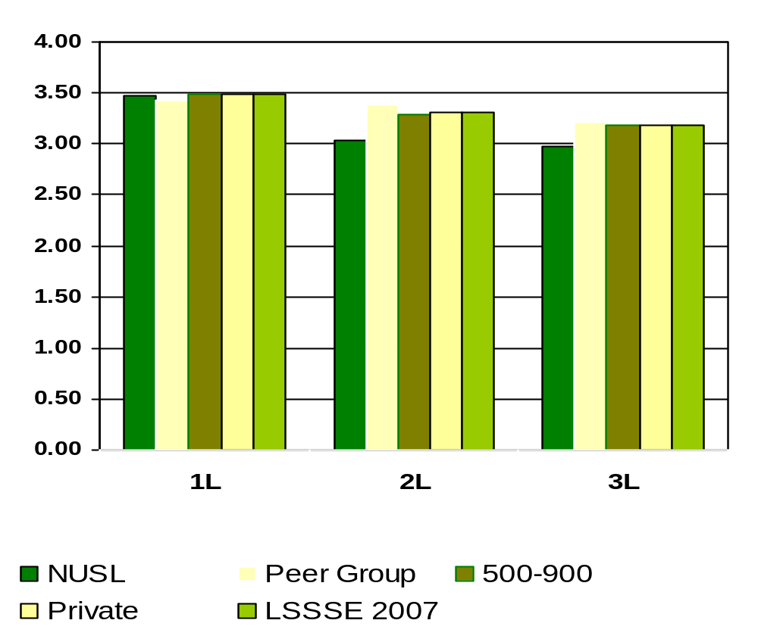
How Much Does Law School Emphasize Spending Significant Amounts of Time Studying and on Academic Work
Means of student responses on a scale of 1 to 4 where 1=Very Little and 4=Very Much
Notes:
Comparative data for these slides is available in the Means Comparisons section. Please enter for checked items only.
To modify this slide, double-click on the slide. Then, enter the appropriate data into the Excel table. Sample data is included in the chart above.

Slide 76
What percent of NUSL students felt the law school environment encourages the ethical practice of the law?
1L
97%
2L
99%
3L
98%
Percentages measure students who believe “Some”, “Quite a bit” or “Very much” versus “Very Little”
Notes:
This section utilizes data from your Law School Report 2007. Using this template, you can create additional slides that address areas of interest for your audience. Insert your law school name and data from your school’s Frequency Distribution Report .

Slide 77
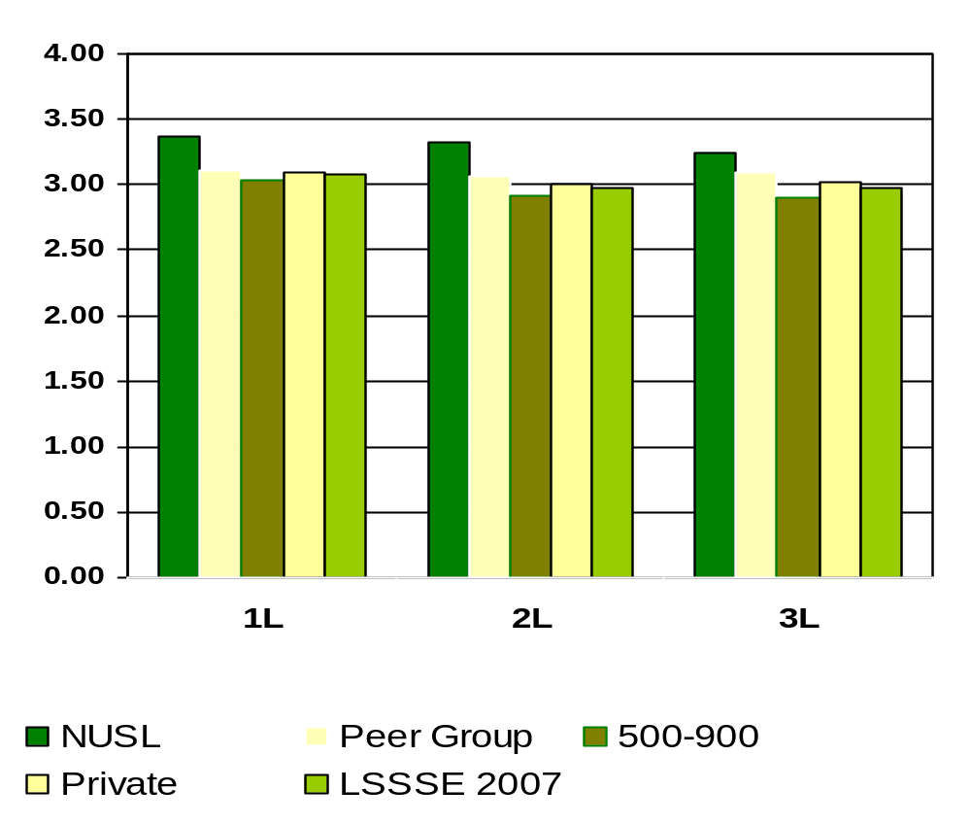
How Much Does Law School Emphasize Encouraging the Ethical Practice of Law
Means of student responses on a scale of 1 to 4 where 1=Very Little and 4=Very Much
Notes:
Comparative data for these slides is available in the Means Comparisons section. Please enter for checked items only.
To modify this slide, double-click on the slide. Then, enter the appropriate data into the Excel table. Sample data is included in the chart above.

Slide 78
What percent of NUSL students felt the law school environment provides the support they need to help succeed academically?
1L
98%
2L
96%
3L
95%
Percentages measure students who believe “Some”, “Quite a bit” or “Very much” versus “Very Little”
Notes:
This section utilizes data from your Law School Report 2007. Using this template, you can create additional slides that address areas of interest for your audience. Insert your law school name and data from your school’s Frequency Distribution Report .

Slide 79
What percent of NUSL students felt the law school environment provides the support they need in their employment search?
1L
95%
2L
92%
3L
83%
Percentages measure students who believe “Some”, “Quite a bit” or “Very much” versus “Very Little”
Notes:
This section utilizes data from your Law School Report 2007. Using this template, you can create additional slides that address areas of interest for your audience. Insert your law school name and data from your school’s Frequency Distribution Report .

Slide 80
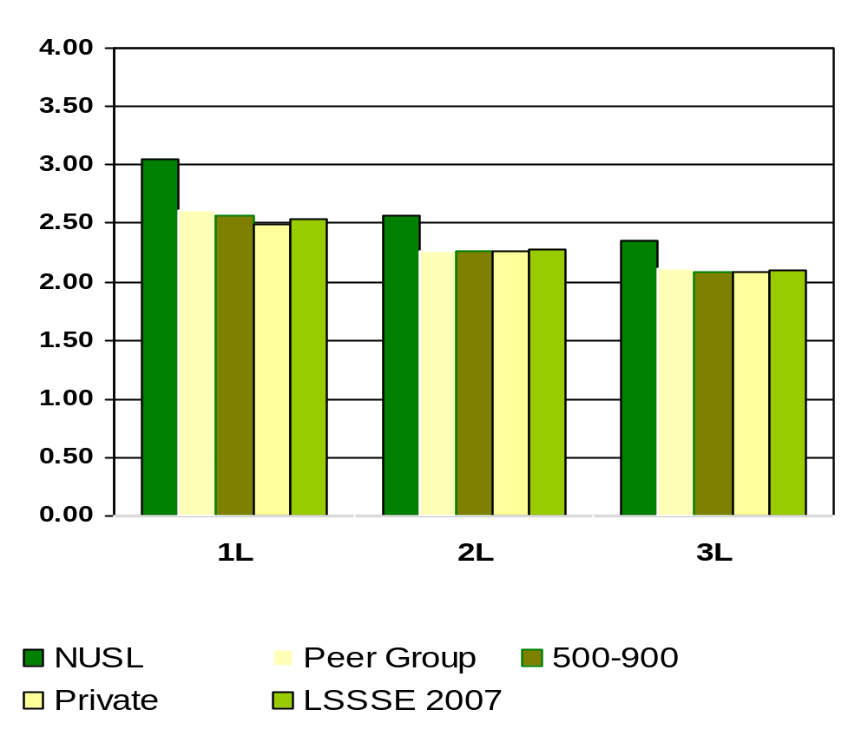
How Much Does Law School Emphasize Providing the Support You Need to Succeed in Your Employment Search
Means of student responses on a scale of 1 to 4 where 1=Very Little and 4=Very Much
Notes:
Comparative data for these slides is available in the Means Comparisons section. Please enter for checked items only.
To modify this slide, double-click on the slide. Then, enter the appropriate data into the Excel table. Sample data is included in the chart above.

Slide 81
What percent of NUSL students felt the law school environment helps them cope with their non-academic responsibilities (work, family, etc.)?
1L
55%
2L
65%
3L
63%
Percentages measure students who believe “Some”, “Quite a bit” or “Very much” versus “Very Little”
Notes:
This section utilizes data from your Law School Report 2007. Using this template, you can create additional slides that address areas of interest for your audience. Insert your law school name and data from your school’s Frequency Distribution Report .

Slide 82
What percent of NUSL students felt the law school environment provides the support they need to thrive socially?
1L
68%
2L
81%
3L
69%
Percentages measure students who believe “Some”, “Quite a bit” or “Very much” versus “Very Little”
Notes:
This section utilizes data from your Law School Report 2007. Using this template, you can create additional slides that address areas of interest for your audience. Insert your law school name and data from your school’s Frequency Distribution Report .

Slide 83
What percent of NUSL students attend campus events and activities (special speakers, cultural events, symposia, etc.)?
1L
94%
2L
95%
3L
90%
Percentages measure students who believe “Some”, “Quite a bit” or “Very much” versus “Very Little”
Notes:
This section utilizes data from your Law School Report 2007. Using this template, you can create additional slides that address areas of interest for your audience. Insert your law school name and data from your school’s Frequency Distribution Report .

Slide 84
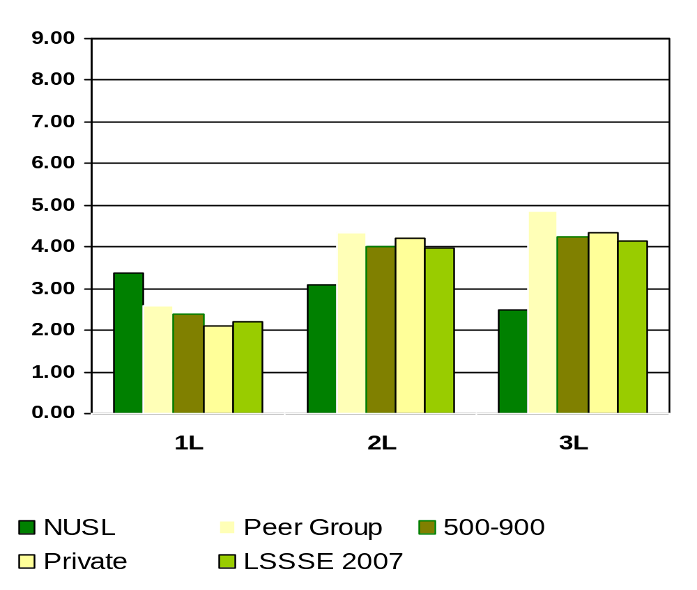
Participating in Law School-Sponsored Activities (organizations, journal, moot court, student bar association, etc.).
Means of student responses on a scale of hours per week
Notes:
Comparative data for these slides is available in the Means Comparisons section. Please enter for checked items only.
To modify this slide, double-click on the slide. Then, enter the appropriate data into the Excel table. Sample data is included in the chart above.

Slide 85
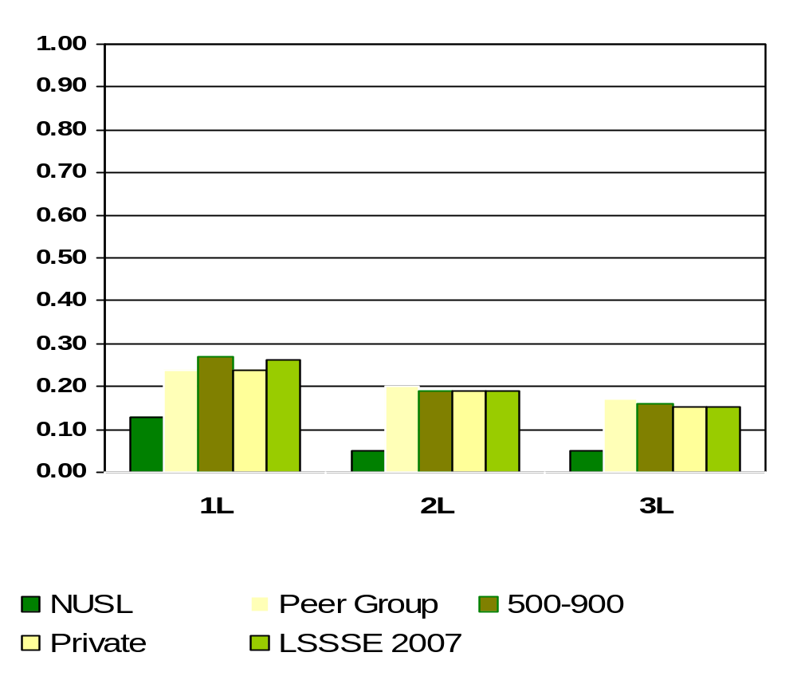
Study Abroad
Means of student responses on a scale of 0 to 1 where 0=Undecided or do not plan to do and 1=Done or plan to do
Notes:
Comparative data for these slides is available in the Means Comparisons section. Please enter for checked items only.
To modify this slide, double-click on the slide. Then, enter the appropriate data into the Excel table. Sample data is included in the chart above.

Slide 86
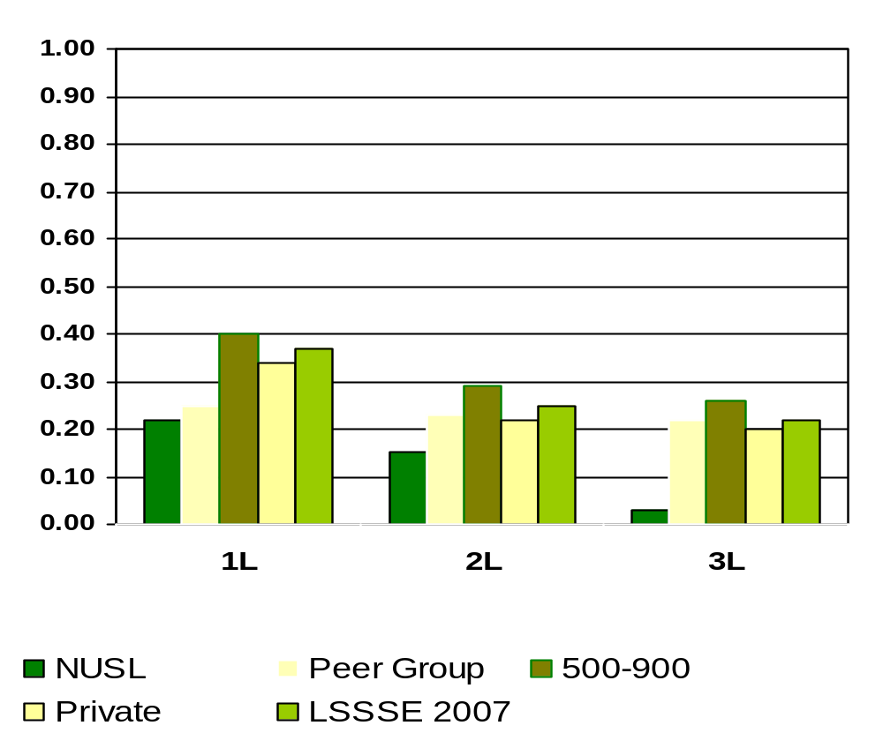
Moot Court Team
Means of student responses on a scale of 0 to 1 where 0=Undecided or do not plan to do and 1=Done or plan to do
Notes:
Comparative data for these slides is available in the Means Comparisons section. Please enter for checked items only.
To modify this slide, double-click on the slide. Then, enter the appropriate data into the Excel table. Sample data is included in the chart above.

Slide 87
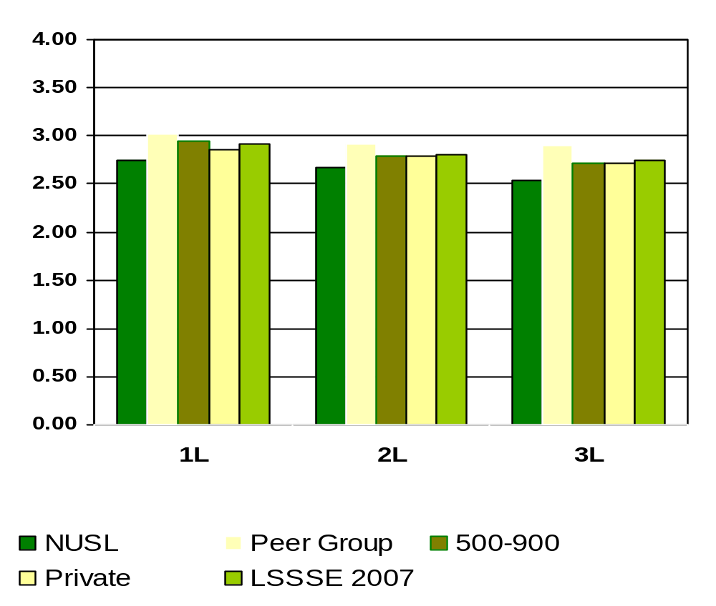
How Much Does Law School Emphasize Attending Campus Events and Activities (special speakers, cultural events, symposia, etc.)
Means of student responses on a scale of 1 to 4 where 1=Very Little and 4=Very Much
Notes:
Comparative data for these slides is available in the Means Comparisons section. Please enter for checked items only.
To modify this slide, double-click on the slide. Then, enter the appropriate data into the Excel table. Sample data is included in the chart above.

Slide 88
What percent of NUSL students felt the law school environment provides the financial aid counseling they need to afford their education?
1L
84%
2L
80%
3L
77%
Percentages measure students who believe “Some”, “Quite a bit” or “Very much” versus “Very Little”
Notes:
This section utilizes data from your Law School Report 2007. Using this template, you can create additional slides that address areas of interest for your audience. Insert your law school name and data from your school’s Frequency Distribution Report .

Slide 89
What percent of NUSL students use computers in academic work?
1L
95%
2L
95%
3L
90%
Percentages measure students who believe “Some”, “Quite a bit” or “Very much” versus “Very Little”
Notes:
This section utilizes data from your Law School Report 2007. Using this template, you can create additional slides that address areas of interest for your audience. Insert your law school name and data from your school’s Frequency Distribution Report .

Slide 90
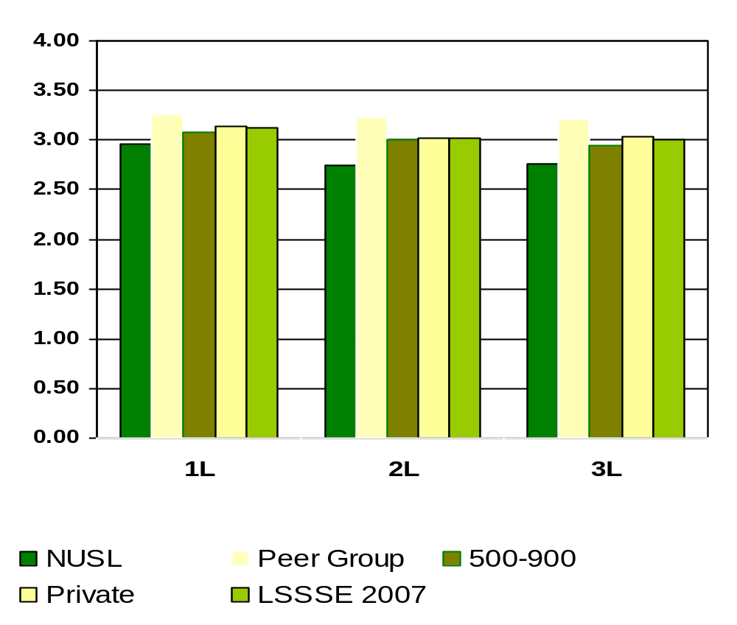
How Much Does Law School Emphasize Using Computers in Academic Work
Means of student responses on a scale of 1 to 4 where 1=Very Little and 4=Very Much
Notes:
Comparative data for these slides is available in the Means Comparisons section. Please enter for checked items only.
To modify this slide, double-click on the slide. Then, enter the appropriate data into the Excel table. Sample data is included in the chart above.

Slide 91
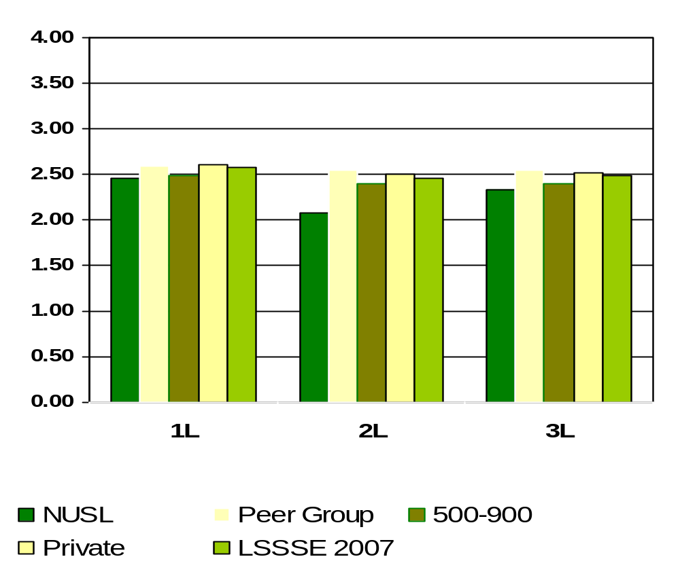
How Much Law School Experience Contributed to Using Computing and Information Technology
Means of student responses on a scale of 1 to 4 where 1=Very Little and 4=Very Much
Notes:
Comparative data for these slides is available in the Means Comparisons section. Please enter for checked items only.
To modify this slide, double-click on the slide. Then, enter the appropriate data into the Excel table. Sample data is included in the chart above.

Slide 92
The quality of relationships with other students at NUSL tends toward friendly, supportive, sense of belonging.
1L
87%
2L
83%
3L
79%
Percentages measure students who lean toward a “friendly, supportive, sense of belonging” relationships versus “unfriendly, unsupportive, sense of alienation” relationships
Notes:
This section utilizes data from your Law School Report 2007. Using this template, you can create additional slides that address areas of interest for your audience. Insert your law school name and data from your school’s Frequency Distribution Report .

Slide 93
The quality of relationships with faculty at NUSL tends towards available, helpful and sympathetic.
1L
78%
2L
82%
3L
73%
Percentages measure students who lean toward a “Available, helpful, sympathetic” relationship versus “unfriendly, unsupportive, sense of alienation” relationship
Notes:
This section utilizes data from your Law School Report 2007. Using this template, you can create additional slides that address areas of interest for your audience. Insert your law school name and data from your school’s Frequency Distribution Report .

Slide 94
The quality of relationships with Administrative Staff and Offices at NUSL tends towards helpful, considerate, flexible.
1L
68%
2L
62%
3L
65%
Percentages measure students who lean toward a “Helpful, considerate, flexible” relationship versus “unhelpful, inconsiderate, rigid” relationship
Notes:
This section utilizes data from your Law School Report 2007. Using this template, you can create additional slides that address areas of interest for your audience. Insert your law school name and data from your school’s Frequency Distribution Report .

Slide 95
What percentage of NUSL students believe the law school contributed significantly to acquiring a broad legal education?
1L
90%
2L
93%
3L
84%
Percentages measure students who believe “Quite a bit” or “Very much” versus “Some” or “Very Little”
Notes:
This section utilizes data from your Law School Report 2007. Using this template, you can create additional slides that address areas of interest for your audience. Insert your law school name and data from your school’s Frequency Distribution Report .

Slide 96
What percentage of NUSL students believe the law school contributed significantly to acquiring job or work-related knowledge and skills?
1L
65%
2L
87%
3L
84%
Percentages measure students who believe “Quite a bit” or “Very much” versus “Some” or “Very Little”
Notes:
This section utilizes data from your Law School Report 2007. Using this template, you can create additional slides that address areas of interest for your audience. Insert your law school name and data from your school’s Frequency Distribution Report .

Slide 97
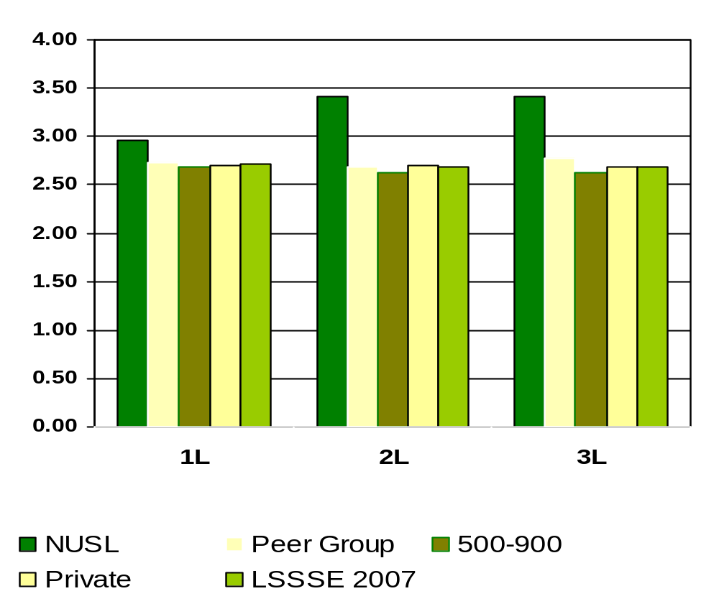
How Much Law School Experience Contributed to Acquiring Job or Work-Related Knowledge and Skills
Means of student responses on a scale of 1 to 4 where 1=Very Little and 4=Very Much
Notes:
Comparative data for these slides is available in the Means Comparisons section. Please enter for checked items only.
To modify this slide, double-click on the slide. Then, enter the appropriate data into the Excel table. Sample data is included in the chart above.

Slide 98
What percentage of NUSL students believe the law school contributed significantly to writing clearly and effectively?
1L
77%
2L
76%
3L
78%
Percentages measure students who believe “Quite a bit” or “Very much” versus “Some” or “Very Little”
Notes:
This section utilizes data from your Law School Report 2007. Using this template, you can create additional slides that address areas of interest for your audience. Insert your law school name and data from your school’s Frequency Distribution Report .

Slide 99
What percentage of NUSL students believe the law school contributed significantly to speaking clearly and effectively?
1L
50%
2L
60%
3L
64%
Percentages measure students who believe “Quite a bit” or “Very much” versus “Some” or “Very Little”
Notes:
This section utilizes data from your Law School Report 2007. Using this template, you can create additional slides that address areas of interest for your audience. Insert your law school name and data from your school’s Frequency Distribution Report .

Slide 100
What percentage of NUSL students believe the law school contributed significantly to thinking critically and analytically?
1L
91%
2L
87%
3L
88%
Percentages measure students who believe “Quite a bit” or “Very much” versus “Some” or “Very Little”
Notes:
This section utilizes data from your Law School Report 2007. Using this template, you can create additional slides that address areas of interest for your audience. Insert your law school name and data from your school’s Frequency Distribution Report .

Slide 101
What percentage of NUSL students believe the law school contributed significantly to developing legal research skills?
1L
77%
2L
67%
3L
73%
Percentages measure students who believe “Quite a bit” or “Very much” versus “Some” or “Very Little”
Notes:
This section utilizes data from your Law School Report 2007. Using this template, you can create additional slides that address areas of interest for your audience. Insert your law school name and data from your school’s Frequency Distribution Report .

Slide 102
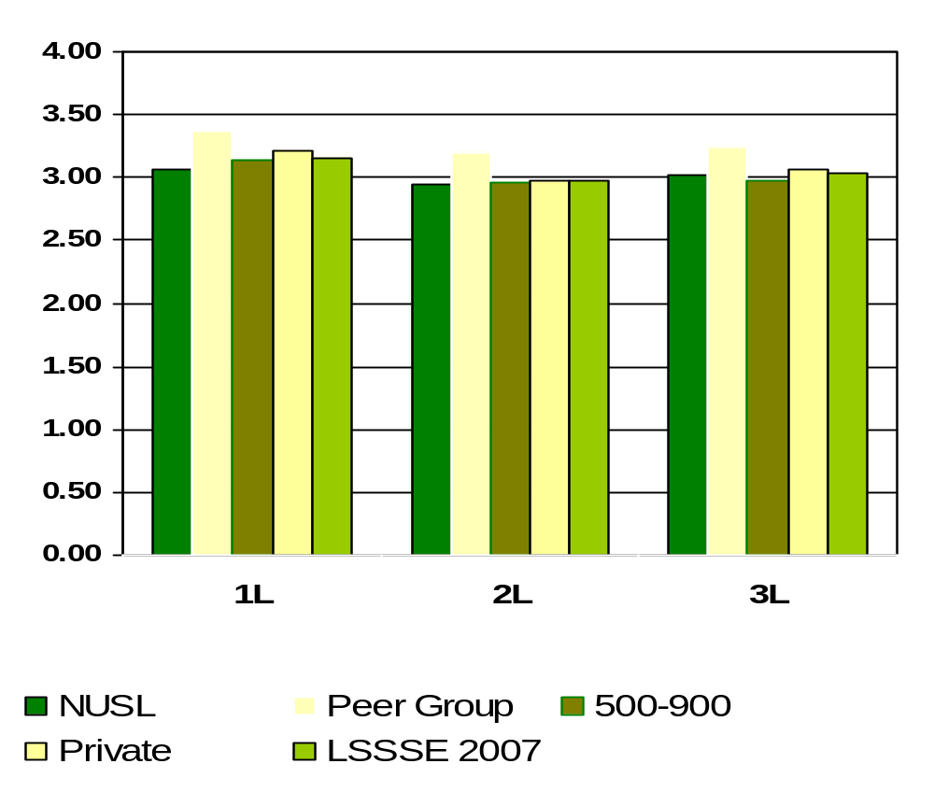
How Much Law School Experience Contributed to Developing Legal Research Skills
Means of student responses on a scale of 1 to 4 where 1=Very Little and 4=Very Much
Notes:
Comparative data for these slides is available in the Means Comparisons section. Please enter for checked items only.
To modify this slide, double-click on the slide. Then, enter the appropriate data into the Excel table. Sample data is included in the chart above.

Slide 103
What percentage of NUSL students believe the law school contributed significantly to working effectively with others?
1L
68%
2L
52%
3L
65%
Percentages measure students who believe “Quite a bit” or “Very much” versus “Some” or “Very Little”
Notes:
This section utilizes data from your Law School Report 2007. Using this template, you can create additional slides that address areas of interest for your audience. Insert your law school name and data from your school’s Frequency Distribution Report .

Slide 104
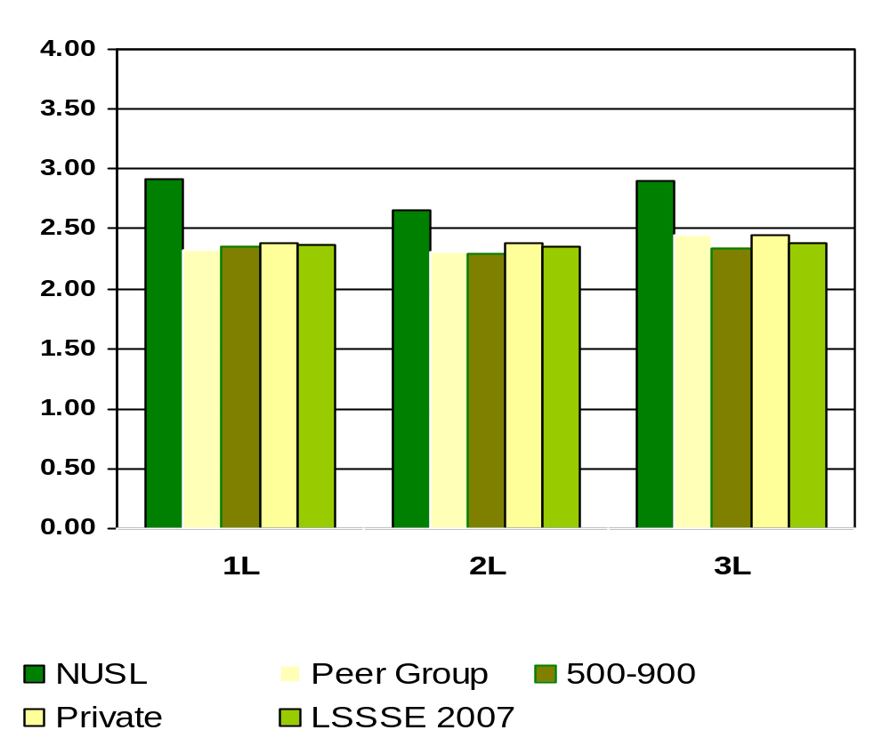
How Much Law School Experience Contributed to Working Effectively with Others
Means of student responses on a scale of 1 to 4 where 1=Very Little and 4=Very Much
Notes:
Comparative data for these slides is available in the Means Comparisons section. Please enter for checked items only.
To modify this slide, double-click on the slide. Then, enter the appropriate data into the Excel table. Sample data is included in the chart above.

Slide 105
What percentage of NUSL students believe the law school contributed significantly to learning effectively on their own?
1L
79%
2L
70%
3L
79%
Percentages measure students who believe “Quite a bit” or “Very much” versus “Some” or “Very Little”
Notes:
This section utilizes data from your Law School Report 2007. Using this template, you can create additional slides that address areas of interest for your audience. Insert your law school name and data from your school’s Frequency Distribution Report .

Slide 106
What percentage of NUSL students believe the law school contributed significantly to understanding themselves?
1L
49%
2L
53%
3L
55%
Percentages measure students who believe “Quite a bit” or “Very much” versus “Some” or “Very Little”
Notes:
This section utilizes data from your Law School Report 2007. Using this template, you can create additional slides that address areas of interest for your audience. Insert your law school name and data from your school’s Frequency Distribution Report .

Slide 107
What percentage of NUSL students believe the law school contributed significantly to solving complex real-world problems?
1L
53%
2L
60%
3L
71%
Percentages measure students who believe “Quite a bit” or “Very much” versus “Some” or “Very Little”
Notes:
This section utilizes data from your Law School Report 2007. Using this template, you can create additional slides that address areas of interest for your audience. Insert your law school name and data from your school’s Frequency Distribution Report .

Slide 108
What percentage of NUSL students believe the law school contributed significantly to developing clearer career goals?
1L
48%
2L
47%
3L
52%
Percentages measure students who believe “Quite a bit” or “Very much” versus “Some” or “Very Little”
Notes:
This section utilizes data from your Law School Report 2007. Using this template, you can create additional slides that address areas of interest for your audience. Insert your law school name and data from your school’s Frequency Distribution Report .

Slide 109
What percentage of NUSL students believe the law school contributed significantly to developing a personal code of values and ethics?
1L
44%
2L
49%
3L
50%
Percentages measure students who believe “Quite a bit” or “Very much” versus “Some” or “Very Little”
Notes:
This section utilizes data from your Law School Report 2007. Using this template, you can create additional slides that address areas of interest for your audience. Insert your law school name and data from your school’s Frequency Distribution Report .

Slide 110
What percentage of NUSL students believe the law school contributed significantly to them contributing to the welfare of their community?
1L
44%
2L
56%
3L
52%
Percentages measure students who believe “Quite a bit” or “Very much” versus “Some” or “Very Little”
Notes:
This section utilizes data from your Law School Report 2007. Using this template, you can create additional slides that address areas of interest for your audience. Insert your law school name and data from your school’s Frequency Distribution Report .

Slide 111
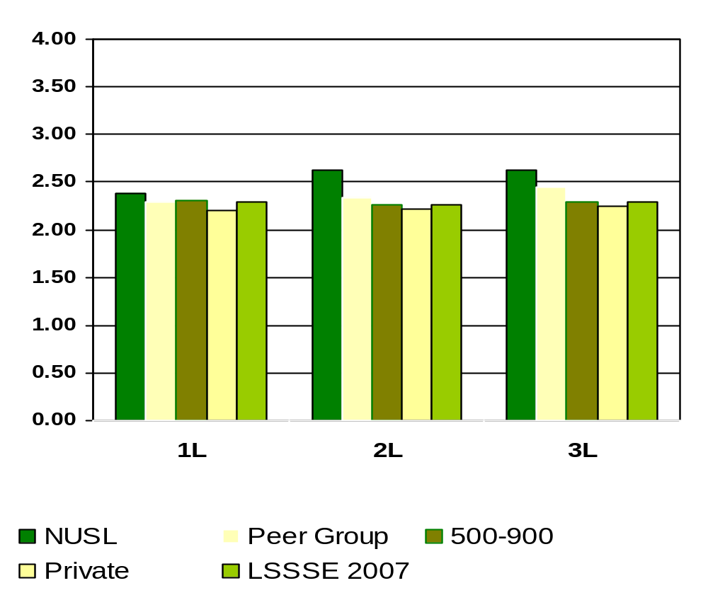
How Much Law School Experience Contributed to Contributing to the Welfare of Your Community
Means of student responses on a scale of 1 to 4 where 1=Very Little and 4=Very Much
Notes:
Comparative data for these slides is available in the Means Comparisons section. Please enter for checked items only.
To modify this slide, double-click on the slide. Then, enter the appropriate data into the Excel table. Sample data is included in the chart above.

Slide 112
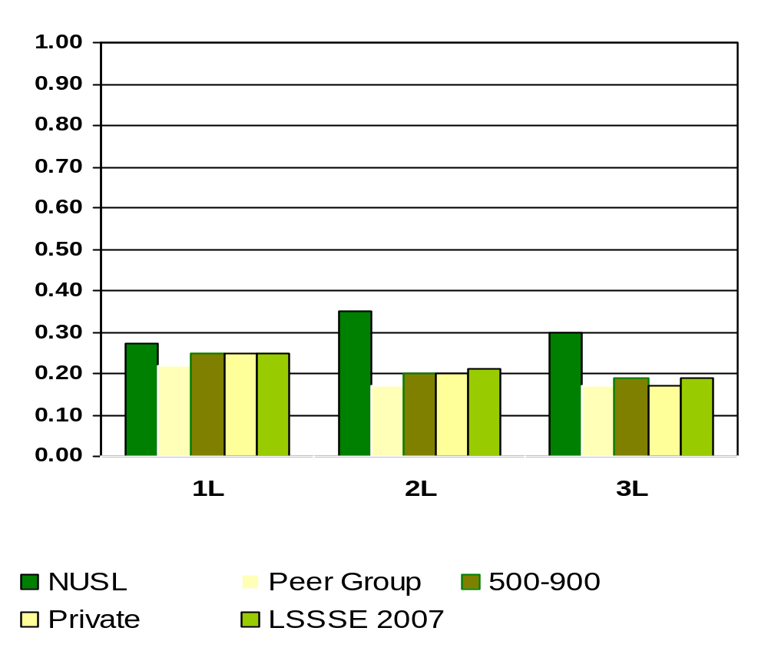
Expectation of Service on a Student-Faculty Committee
Means of student responses on a scale of 0 to 1 where 0=Undecided or do not plan to do and 1=Done or plan to do
Notes:
Comparative data for these slides is available in the Means Comparisons section. Please enter for checked items only.
To modify this slide, double-click on the slide. Then, enter the appropriate data into the Excel table. Sample data is included in the chart above.

Slide 113
What percentage of NUSL students evaluate their entire educational experience as good to excellent?
1L
85%
2L
90%
3L
80%
Percentages measure students who believe “Good” or “Excellent” versus “Fair” or “Poor”
Notes:
This section utilizes data from your Law School Report 2005. Using this template, you can create additional slides that address areas of interest for your audience. Insert your law school name and data from your school’s Frequency Distribution Report .

Slide 114
What percentage of NUSL students would probably or definitely go to the same law school if they could start over again?
1L
86%
2L
90%
3L
79%
Notes:
This section utilizes data from your Law School Report 2005. Using this template, you can create additional slides that address areas of interest for your audience. Insert your law school name and data from your school’s Frequency Distribution Report .

Slide 115
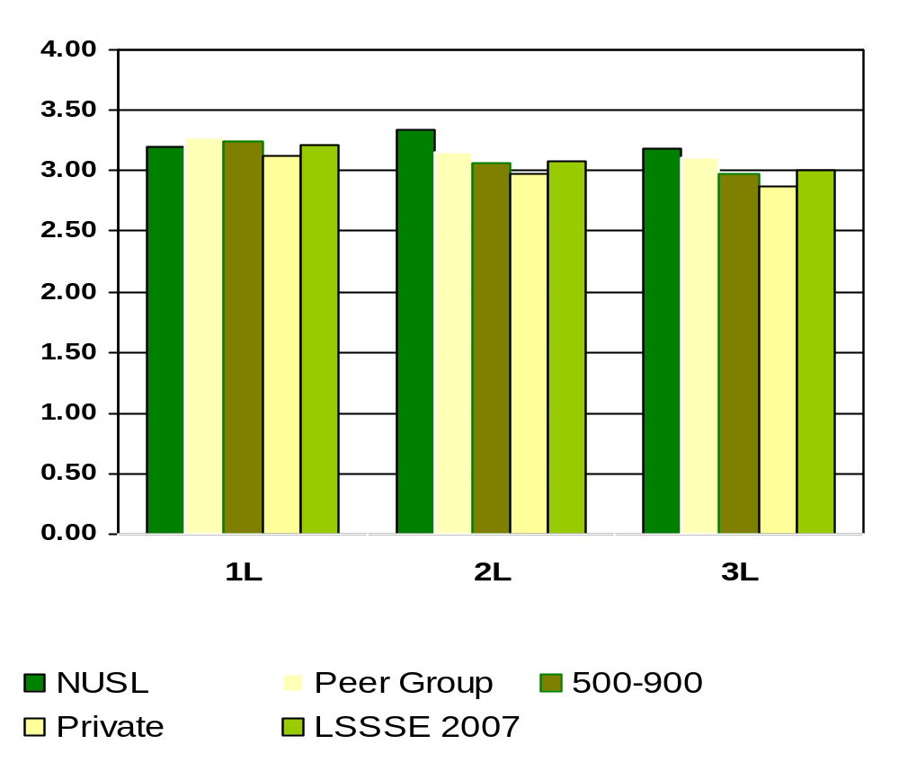
If You Could Start Over Again, Would You Go to the Same Law School You Are Now Attending?
Means of student responses on a scale of 1 to 4 where 1=Definitely No and 4=Definitely Yes
Notes:
Comparative data for these slides is available in the Means Comparisons section. Please enter for checked items only.
To modify this slide, double-click on the slide. Then, enter the appropriate data into the Excel table. Sample data is included in the chart above.

Slide 116
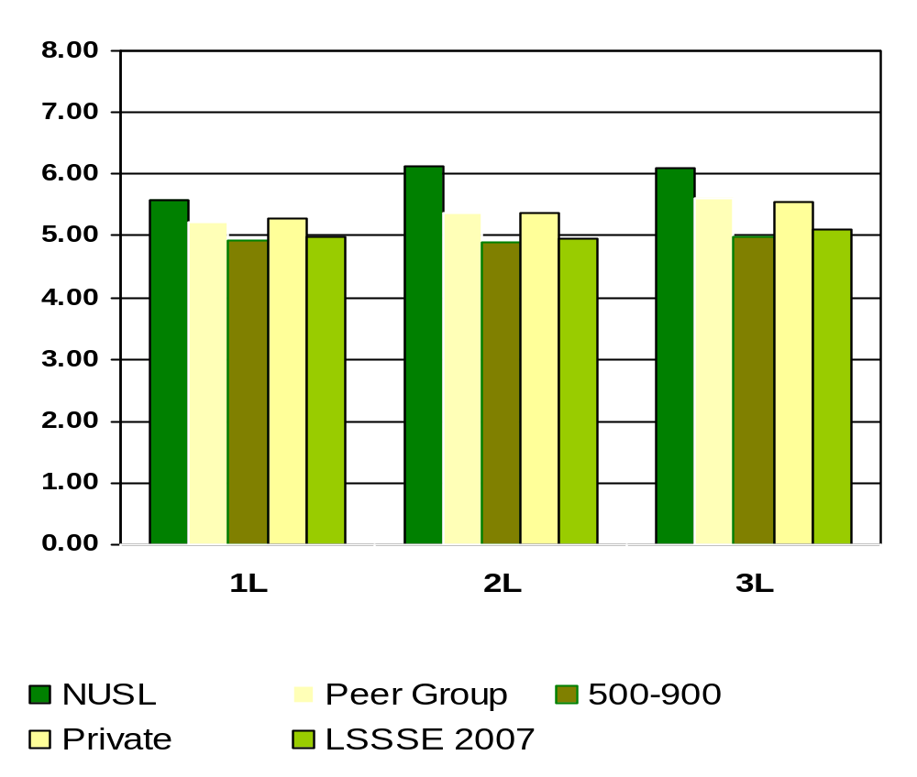
How Much Educational Debt From Attending Law School Do You Expect to Have Upon Your Graduation?
Means of student responses on a scale of 1 to 8 where 1=$0, 2=$1-$20,000, 3=$20,001-$40,000, 4=$40,001-$60,000, 5=60,001-$80,000, 6=$80,001-$100,000, 7=$100,001-$120,000 and 8=More than $120,000
Notes:
Comparative data for these slides is available in the Means Comparisons section. Please enter for checked items only.
To modify this slide, double-click on the slide. Then, enter the appropriate data into the Excel table. Sample data is included in the chart above.

